Slide 1
0.1-Hz, Petawatt CPA Ti:sapphire Laser System
Potential Front-end System for Tens of PW Laser System
T.M. Jeong, J.H. Sung, S.K. Lee, T.J. Yu, and J. Lee
Advanced Photonics Research Institute, GIST

Slide 2
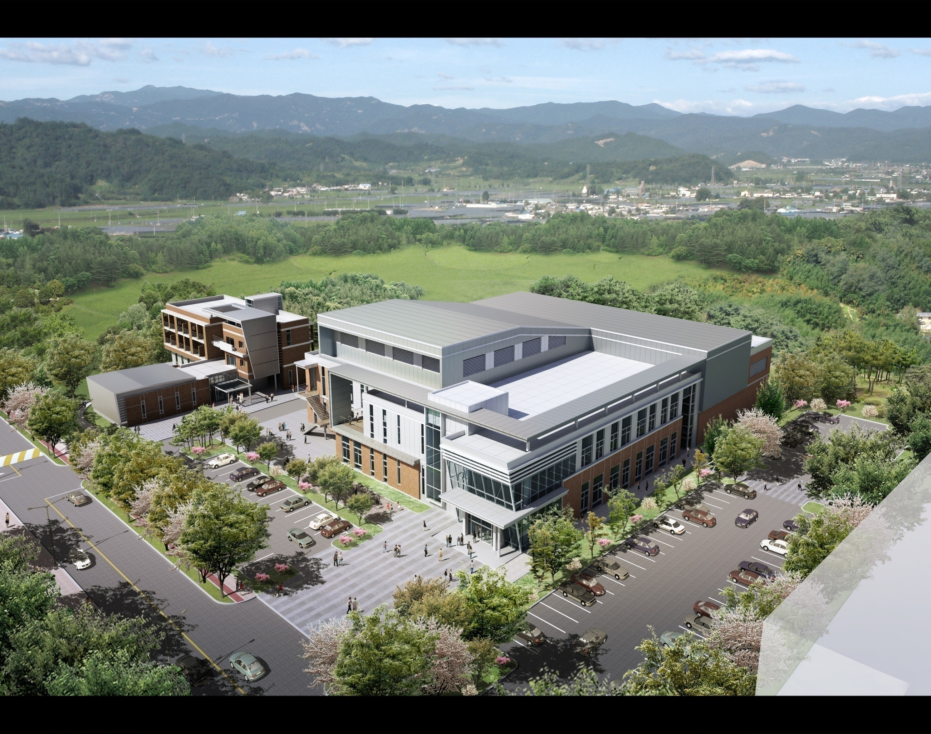

Ultrashort Quantum Beam Facililty (UQBF)
- Petawatt CPA Ti:sapphire Laser System
- Interaction chambers for energetic particles and X-ray laser generations
Korean Ultra-intense Laser Facility
International Hall
Main Research Building

Slide 3
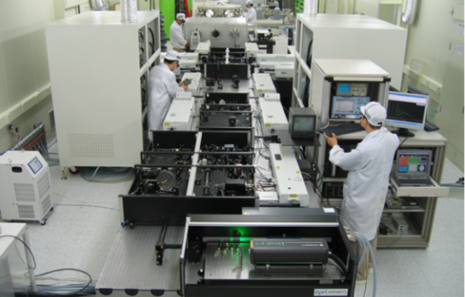

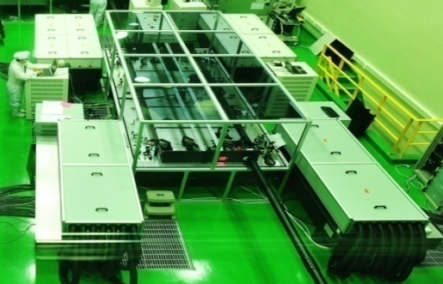
Brief Review on UQBF Project
2003
2004
2005
2006
2008
2010
2011
2012
Operates as a
User Facility
Project started
Facility construction started
30 TW system installed
Facility construction completed
PW beamline II completed
*UQBF-1PW/B2
100 TW system installed
PW beamline I completed
*UQBF-100TW
*UQBF-1PW/B1

Slide 4
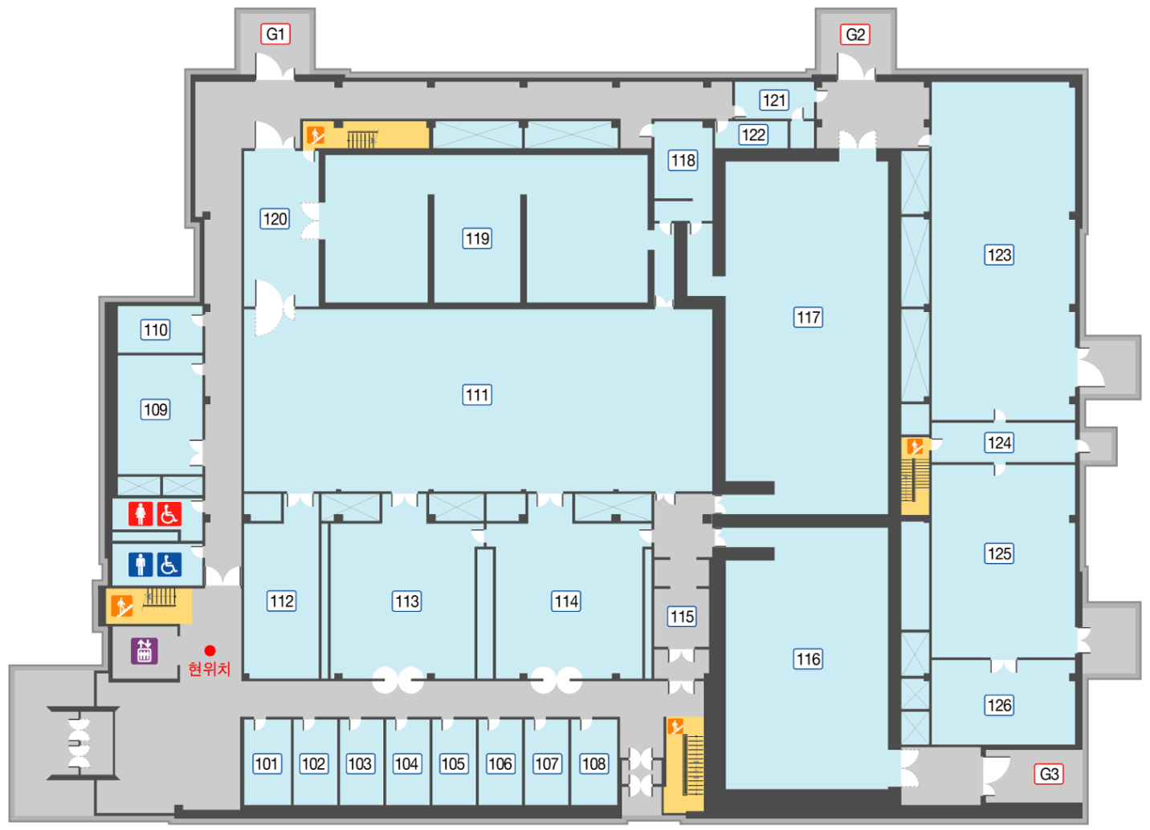
Floor Plan of Research Building
100 TW
laser-plasma
laboratory
Facility Maintenance
PW
laser-plasma
laboratory
Laser Laboratory
Electron
accelerator
laboratory

Slide 5
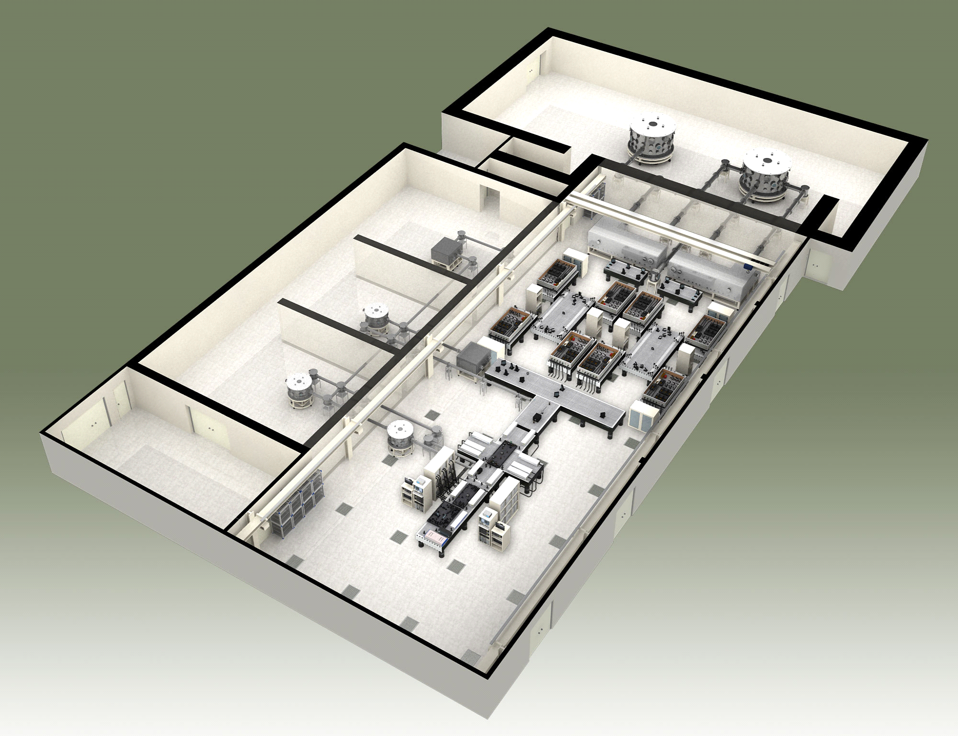
In the Laboratories, we have
Target Room
for Ultraintense Laser Pulse
Target Room
for intense Laser Pulse
Lab. for X-ray Laser Experiment
Lab. for Electron Experiment
Lab. for Proton Experiment
High Energy Laser Lab.
OPCPA laser system
(1 kHz, 1 mJ Regen. Amp.)
Depository and Preparatory
PW Laser Lab.
High-rep. rate Laser Lab.
Femtosecond Laser Oscillator
20fs/5mJ/1kHz laser system
40fs/30uJ/100kHz laser system

Slide 6
Optical Layout of PW CPA Ti:sapphire Laser
Nd:YLF laser
10mJ/ 1kHz
Nd:YAG laser
120mJ/ 10Hz
Oscillator
10fs/ 5nJ/ 75MHz
Multi-pass Amp. System 25fs/ 1mJ/ 1kHz
Grating Stretcher
1ns/ 0.4 mJ/ 1kHz
Pre-amplifier
1ns/ 50mJ/ 10Hz
Grating Stretcher
~ 0.5 ns
PW beamlines
Nd:glass laser
12×8.5J/ 0.1Hz
Beam line I
Nd:YAG laser
8×1J/ 10Hz
Nd:YAG laser
4×1J/ 10Hz
PW Compressor
30fs/ 33J/ 0.1Hz
Booster Amp.
1ns/ 47J/ 0.1Hz
Target
Chamber
2nd Power Amp.
1ns/ 4.5J/ 10Hz
1st Power Amp.
1ns/ 1.8J/ 10Hz
PW Compressor
30fs/ 33J/ 0.1Hz
Booster Amp.
1ns/ 47J/ 0.1Hz
100TW Compressor
30fs/ 3J/ 10Hz
Beam line II
Nd:glass laser
12×8.5J/ 0.1Hz
Under construction
100 TW laser system

Slide 7
UQBF – 100TW
1. Master Oscillator: 20 fs, 4.5 nJ
2. Stretcher: 340 ps
3. Regen. Amp.: 0.7 mJ with 10-mJ pump at 1 kHz
(10 Hz after pulse picker)
6. 2nd Amp: 3 pass, 5.6 J with 10-J pump at 10 Hz
7. Compressor: 3.6 J, 32 fs, >100 TW at 10 Hz
Pump Laser 8
Pump Laser 12
Pump Laser 10
Stretcher
Pump Laser 4
Pump Laser 6
Pump Laser 14
Pre-Amp.
Vacuum
Compressor
Master
Oscillator
Regen. Amp.
1st Main Amp.
2nd Main Amp.
Pump
Laser 1
Pump Laser 2
Pump Laser 3
Pump Laser 5
Pump Laser 13
4. Pre-Amp.: 4 pass, 45 mJ, 130-mJ pump at 10 Hz
5. 1st Amp.: 4 pass, 2 J with 5-J pump at 10 Hz
(30 TW with direct pulse compression)
Green pump lasers
Pump Laser 1: Nd:YLF (SHG), 527 nm,
20 mJ at 1 kHz (JADE series)
Pump Laser 2: Nd:YAG (SHG), 532 nm,
200 mJ at 10 Hz (COMP series)
Pump Laser 3-14: Nd:YAG (SHG), 532 nm,
1.2 J at 10 Hz (SAGA series)
Pump Laser 9
Pump Laser 11
Pump Laser 7
Modified version of a commercial 100 TW Ti:sapphire Laser
▪ Pulse duration : 32 – 35 fs
▪ Maximum output energy : 3.6 J
▪ Repetition rate : 10 Hz

Slide 8
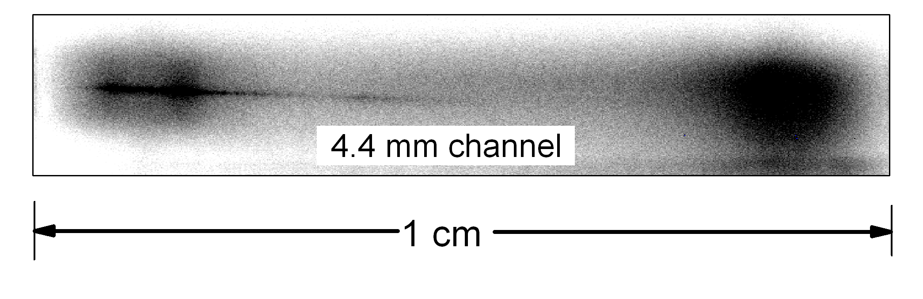

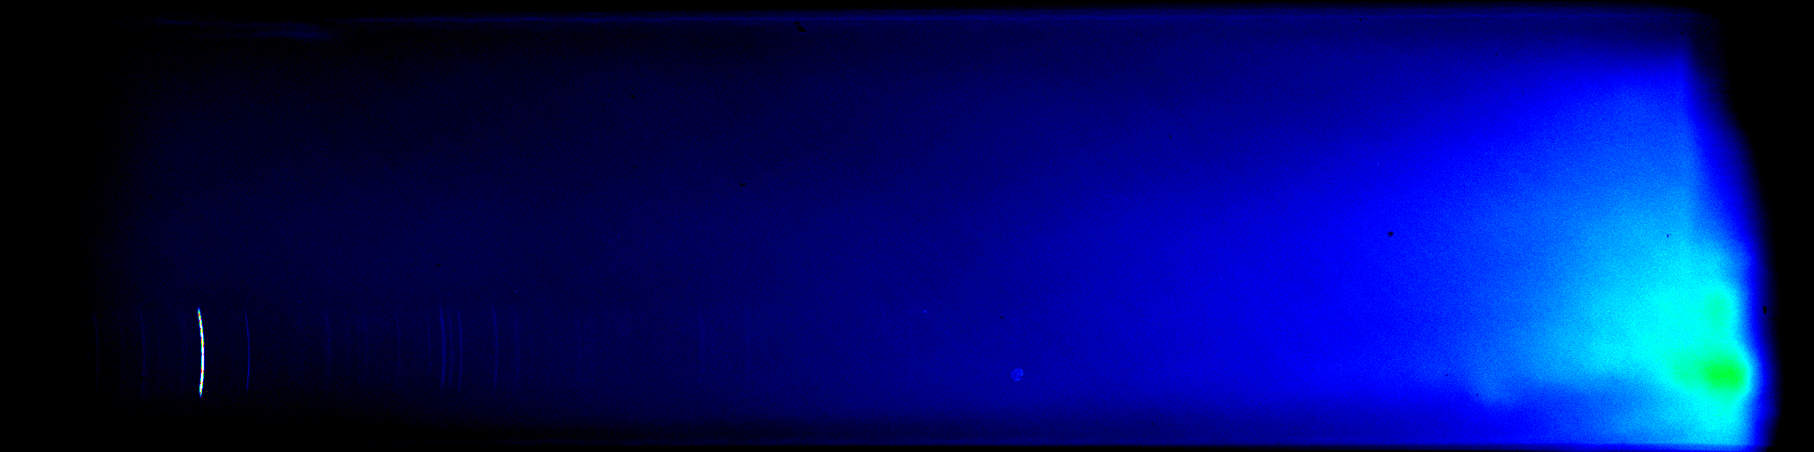
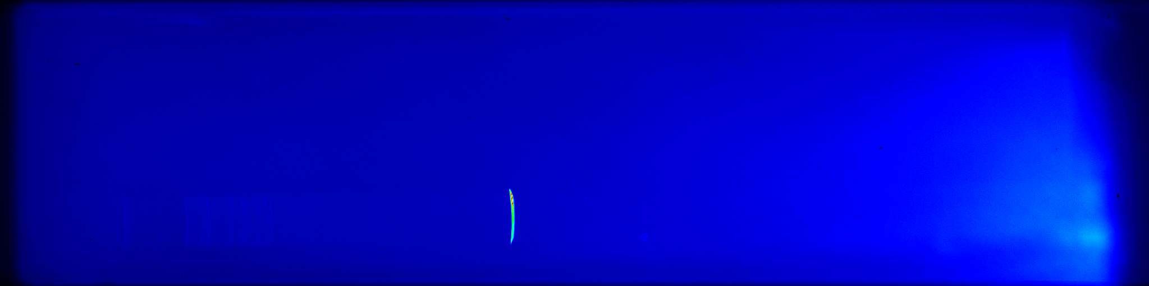
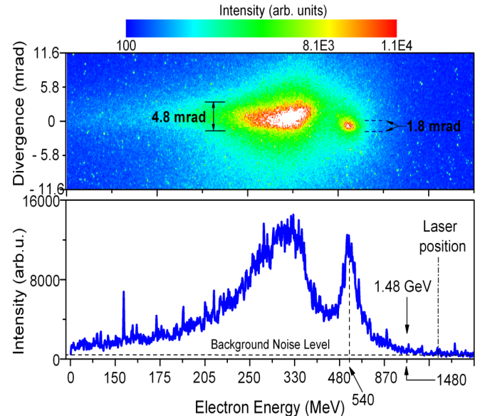
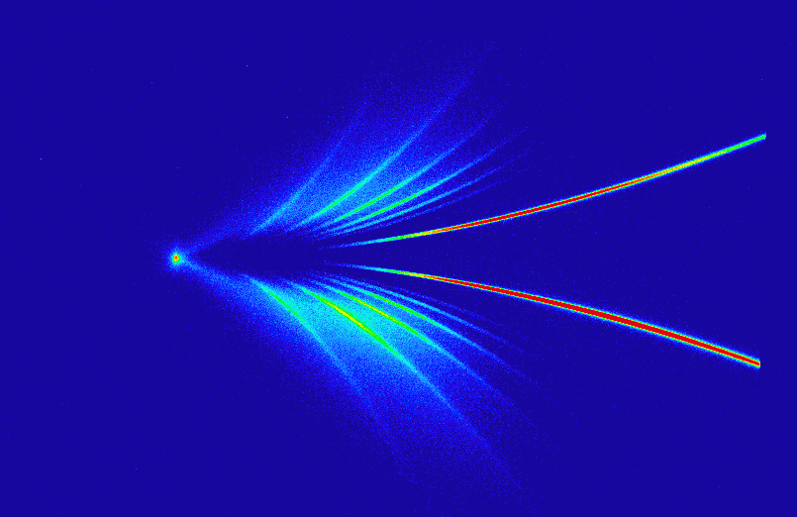
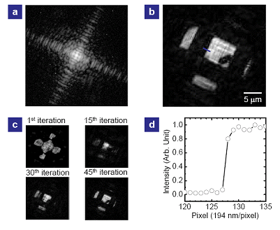
What we’ve done with UQBF-100TW
Electron Beam
Proton Beam
X-ray Laser
Plasma Channel
Spectrum (Proton)
Lasing Lines
Carbon ions
included
Ag
5 mm Channel
Kr
8 MeV
Spectrum (Electron)
Protons
Xe
Target
Laser
13.9 nm
32.8 nm
41.8 nm
Spectrum (Ion)
Wavelength
Diffraction Imaging
with X-ray Laser
Polymer 20 nm
C⁺
C²⁺
C³⁺
C⁴⁺
C⁵⁺
C⁶⁺
1 MeV
0.5 MeV
Maximum Electron Energy: 1.48 GeV
Selected Publications
Selected Publications
Selected Publications
N. Hafz et al., APL (2007)
N. Hafz et al., Nat. Photonics (2008)
IW Choi et al., RSI (2009)
KH Pae et al., PoP (2009)
HT Kim et al., PRA (2008)
CM Kim et al., PRL (2010)

Slide 9
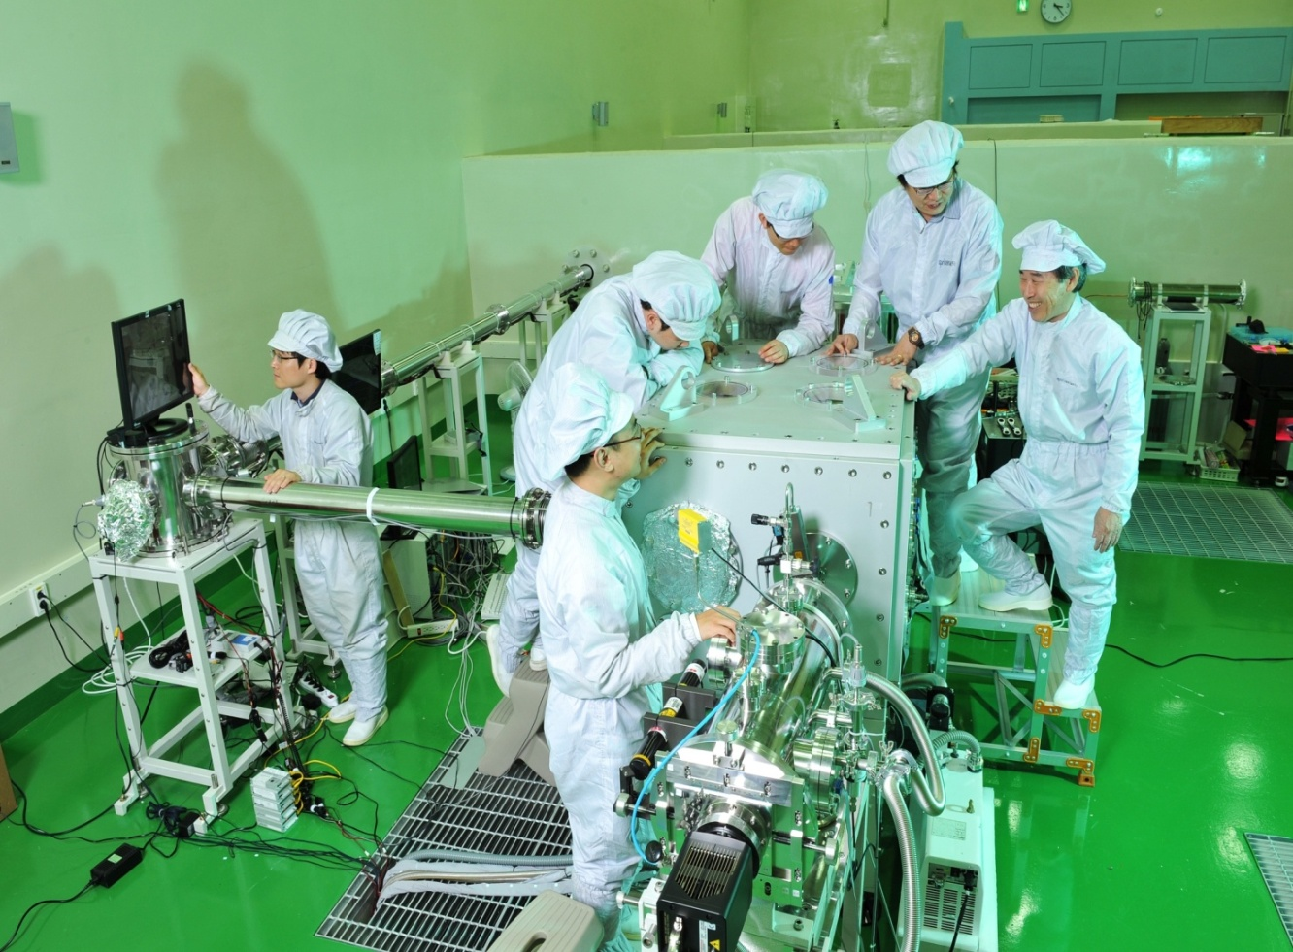
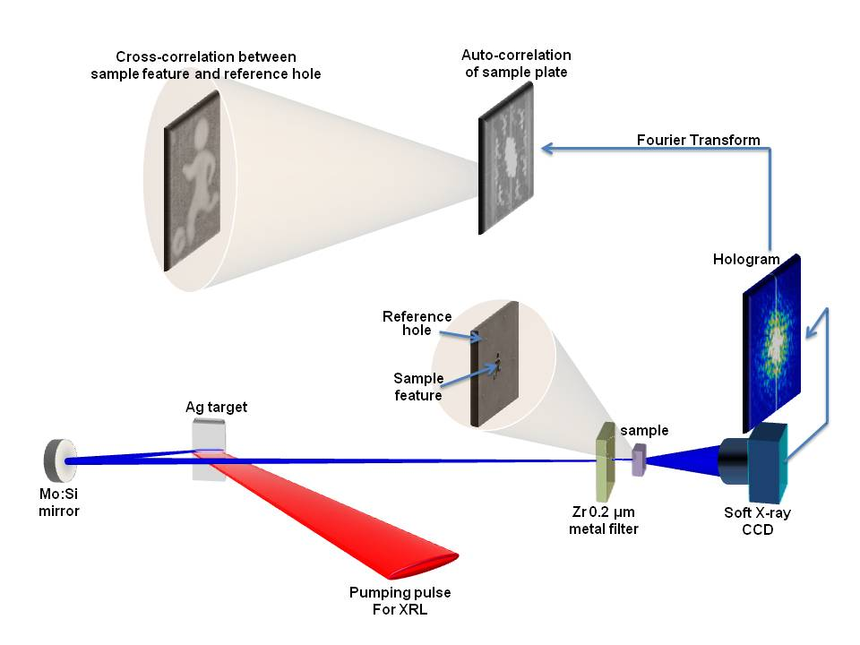
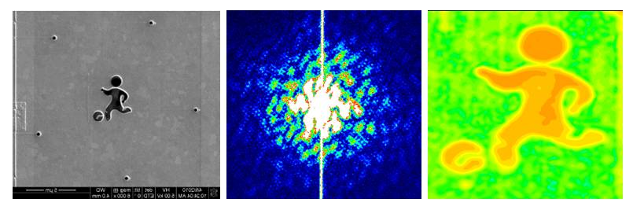
Ongoing Experiments with UQBF-100TW (1)
Single-shot Nanometer-scale Imaging Experiment
(Fourier transform X-ray Holography)
100TW Laser Beam
Delivery and Control
X-ray Laser Generation Chamber
First demonstration of X-ray holography
using X-ray laser
HT Kim et al., submitted to APL

Slide 10
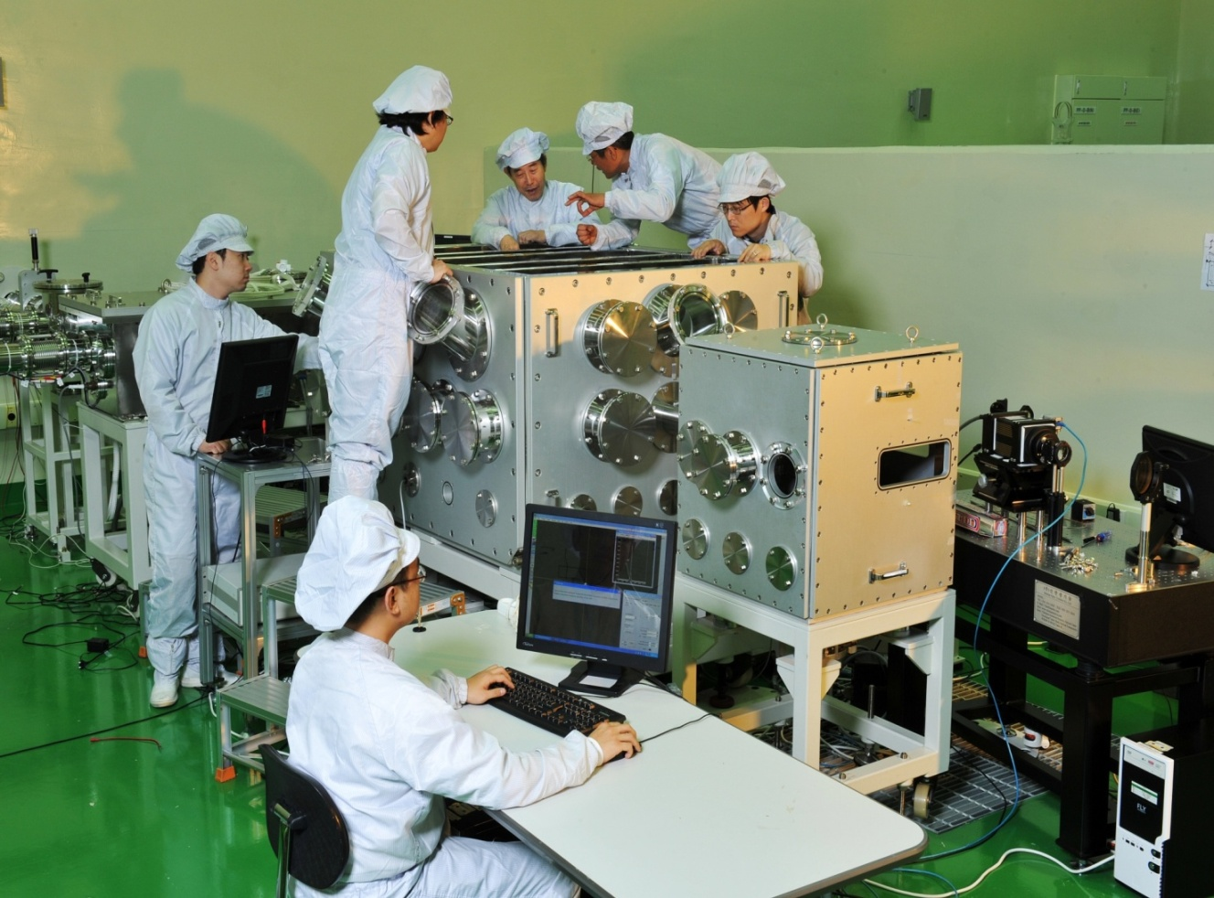
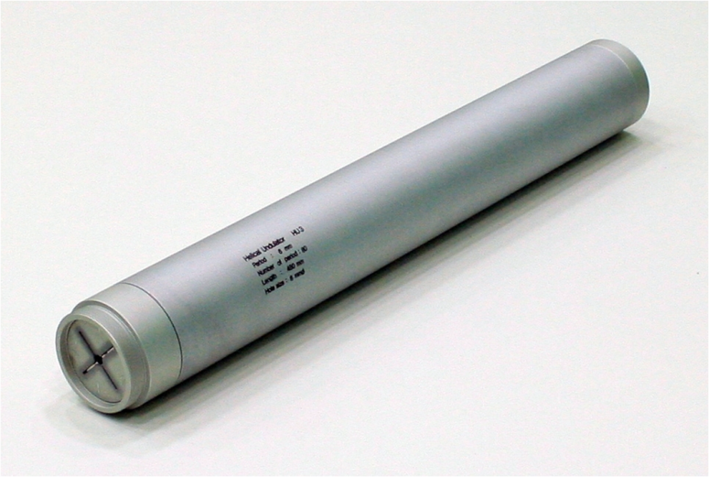
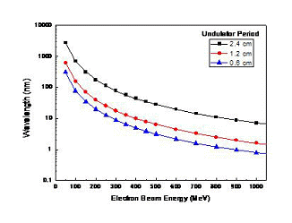
Ongoing Experiments with UQBF-100TW (2)
Electron Acceleration and Circularized Polarized X-ray generation using Helical undulator
100TW Laser Beam
Length : 500 mm
Outer Dia. : 70 mm
Inner Dia. : 6 mm
Electron Acceleration
Chamber
Magnet configuration
Undulator
Wavelength (nm)
1-10 nm wavelength
Electron beam energy (MeV)

Slide 11
Optical Layout of PW CPA Ti:sapphire Laser
Nd:YLF laser
10mJ/ 1kHz
Nd:YAG laser
120mJ/ 10Hz
Oscillator
10fs/ 5nJ/ 75MHz
Multi-pass Amp. System 25fs/ 1mJ/ 1kHz
Grating Stretcher
1ns/ 0.4 mJ/ 1kHz
Pre-amplifier
1ns/ 50mJ/ 10Hz
Grating Stretcher
~ 0.5 ns
PW beamlines
Nd:glass laser
12×8.5J/ 0.1Hz
Beam line I
Nd:YAG laser
8×1J/ 10Hz
Nd:YAG laser
4×1J/ 10Hz
PW Compressor
30fs/ 33J/ 0.1Hz
Booster Amp.
1ns/ 47J/ 0.1Hz
Target
Chamber
2nd Power Amp.
1ns/ 4.5J/ 10Hz
1st Power Amp.
1ns/ 1.8J/ 10Hz
PW Compressor
30fs/ 33J/ 0.1Hz
Booster Amp.
1ns/ 47J/ 0.1Hz
100TW Compressor
30fs/ 3J/ 10Hz
Beam line II
Nd:glass laser
12×8.5J/ 0.1Hz
Under construction
100 TW laser system

Slide 12
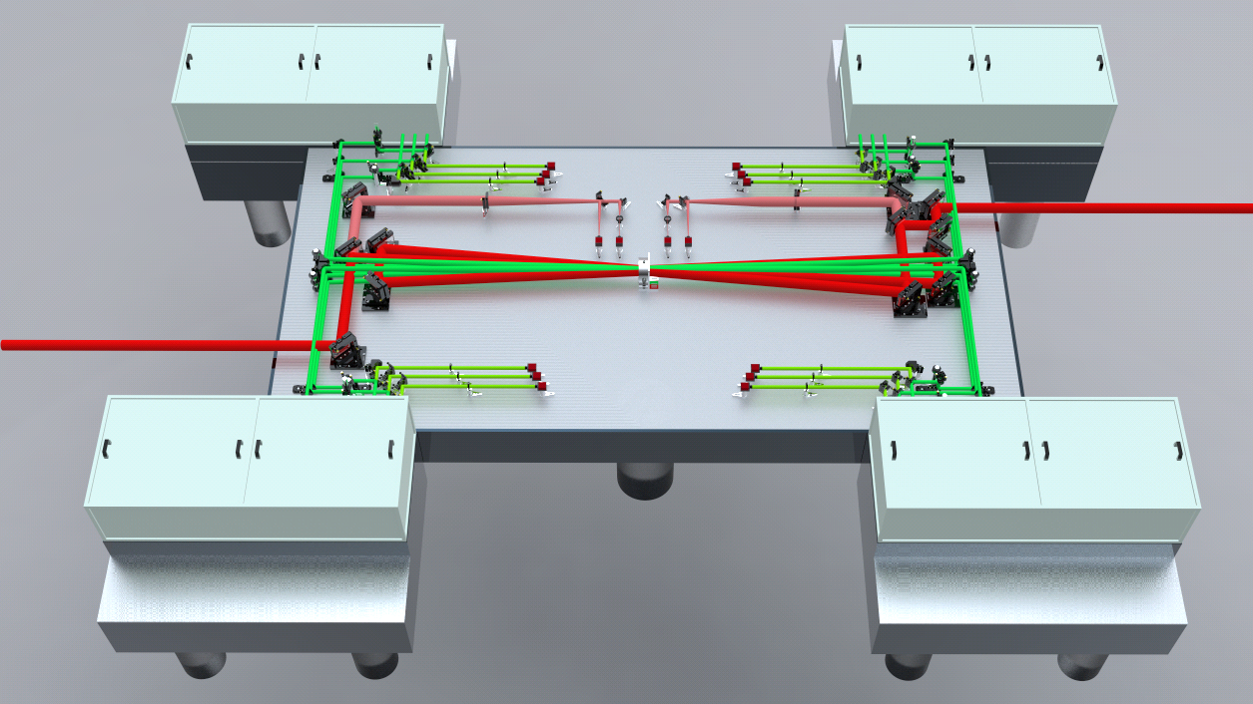
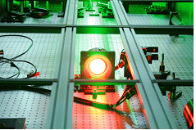
0.1-Hz Booster Ti:sapphire Amplifier
25 J at 532 nm
25 J at 532 nm
3 pass, 60-mm Dia.
E_{in} =
4.5 J (100 TW)
E_{out} = 47 J
25 J at 532 nm
25 J at 532 nm

Slide 13
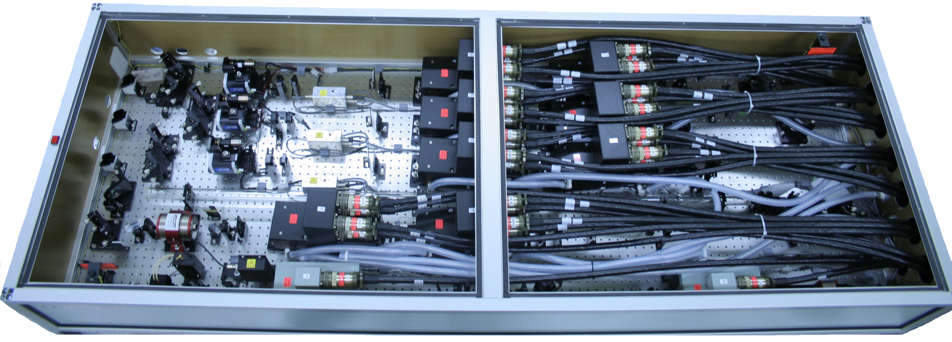
25 J green Nd:glass pump laser
Frequency-doubled Nd:glass pump laser system
(3 legs X 8.5 J@532 nm = 25.5 J @532 nm)
16 or 19 mm beam diameter
Leg1
Leg2
2nd Amp.
Leg3
1st Amp.
Oscillator
Pre. Amp.

Slide 14
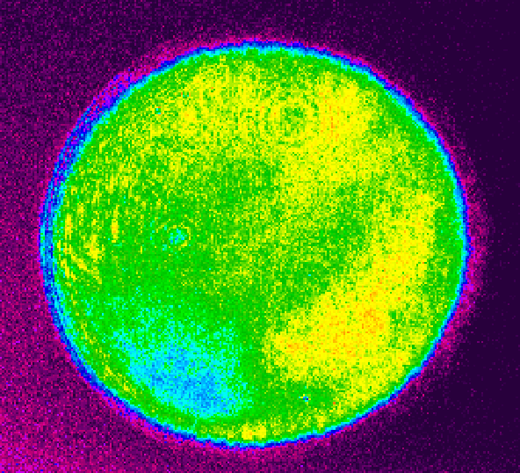
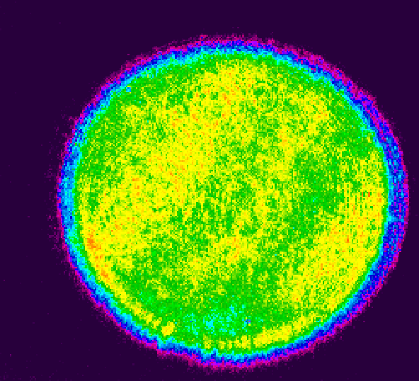
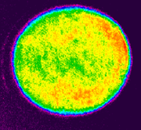
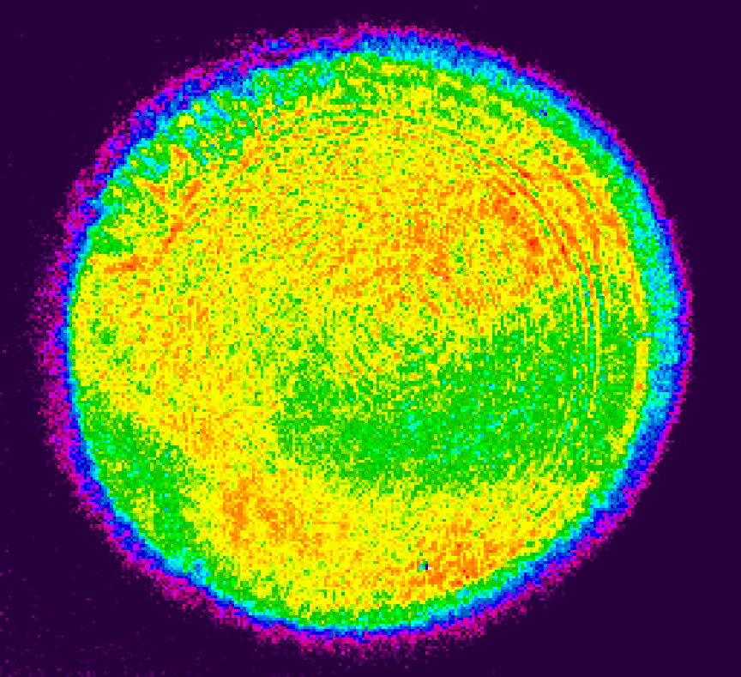
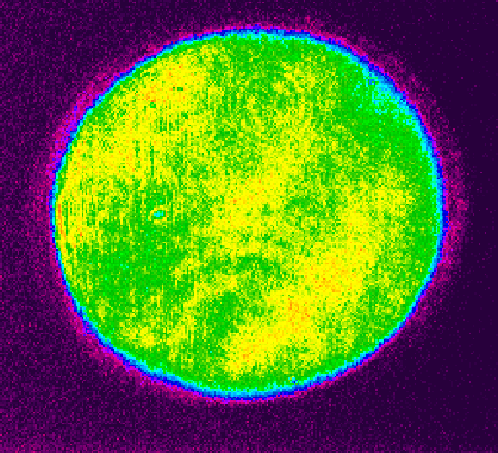
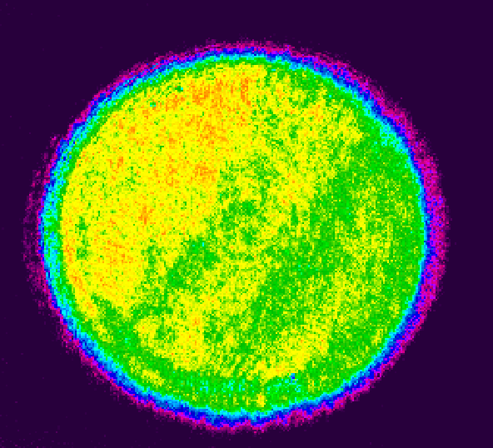
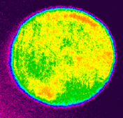
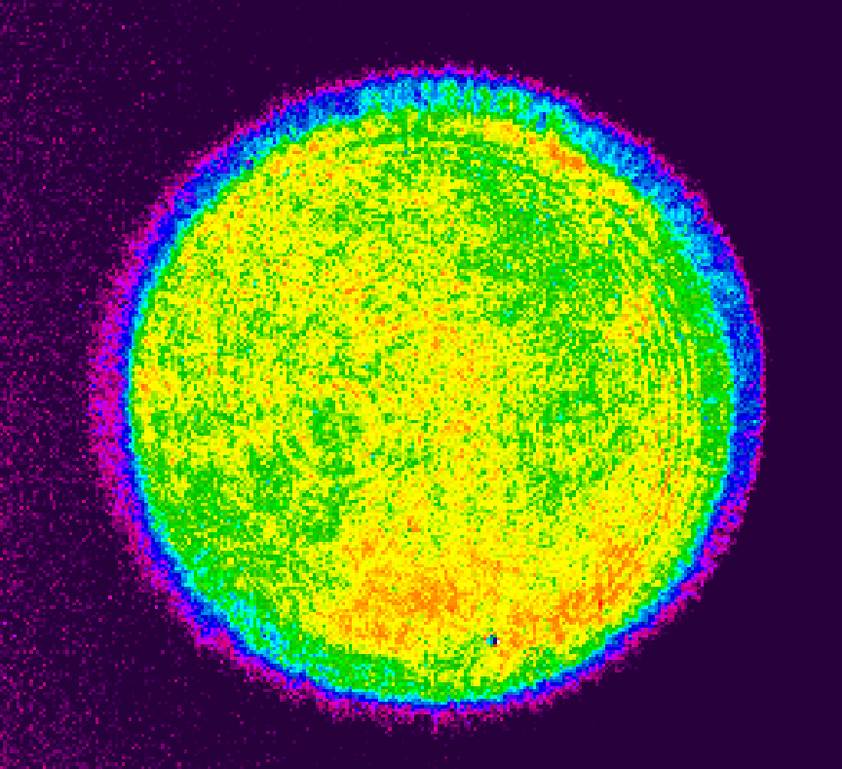
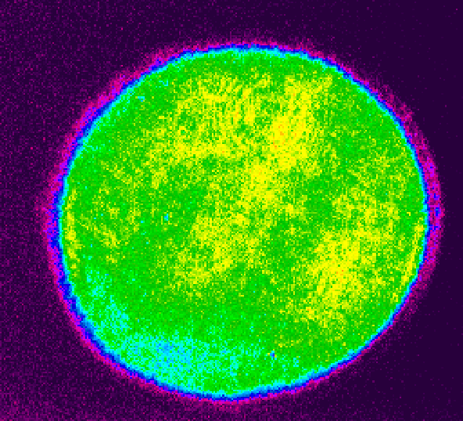
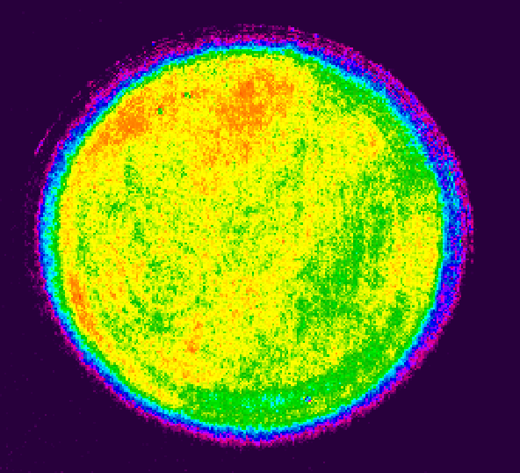
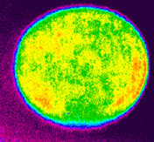
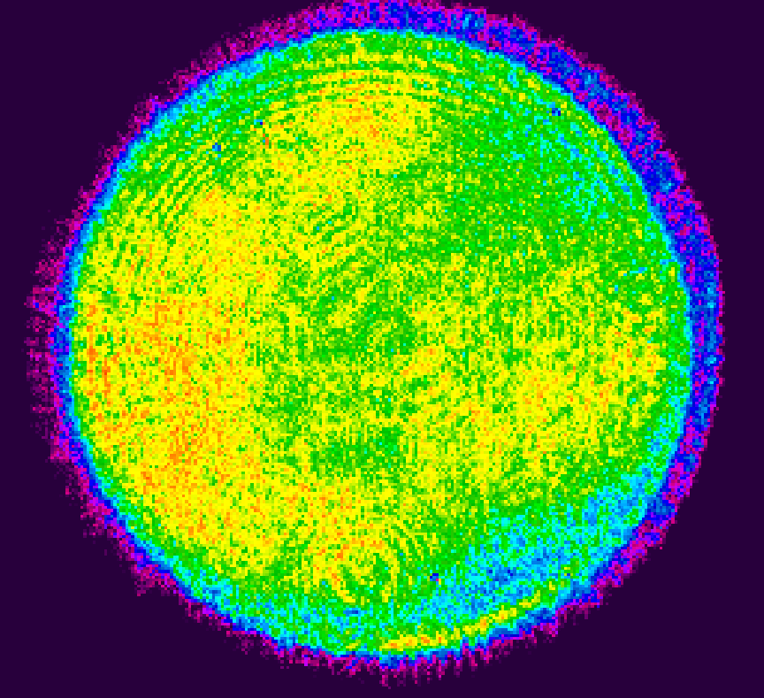
Spatial Profiles for all 12 pump beams
1st pump laser
2nd pump laser
3rd pump laser
4th pump laser
Leg #1
Leg #2
Leg #3

Slide 15
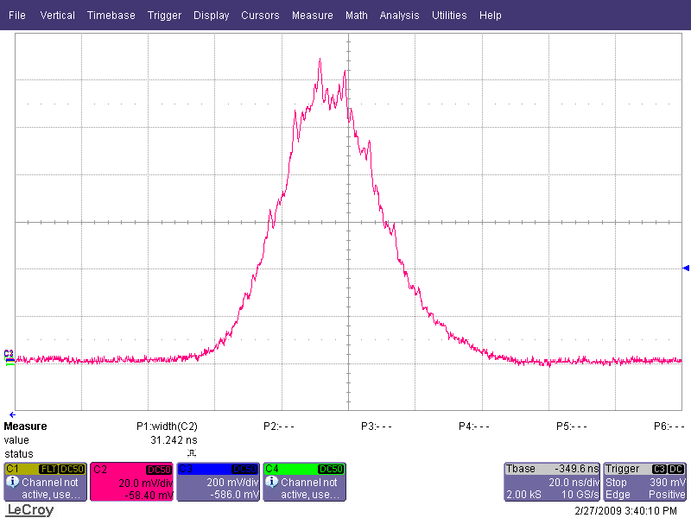
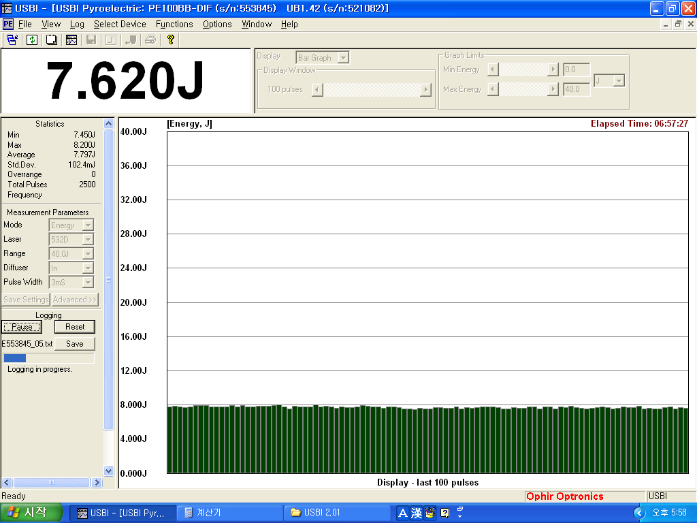
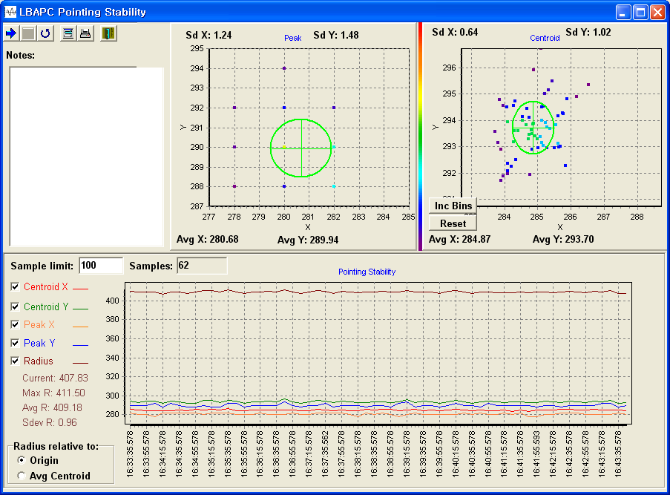
Output Performances of pump laser
Pulse duration
Energy stability
31 ns
<1.2 %(rms) for 8 hours
Pointing stability
Advantages
▪ Small diameter
▪ Large number of beamlines
- make the laser system faster
- improve the beam profile
X-axis: 4.6 µrad, Y-axis: 5.7 µrad

Slide 16
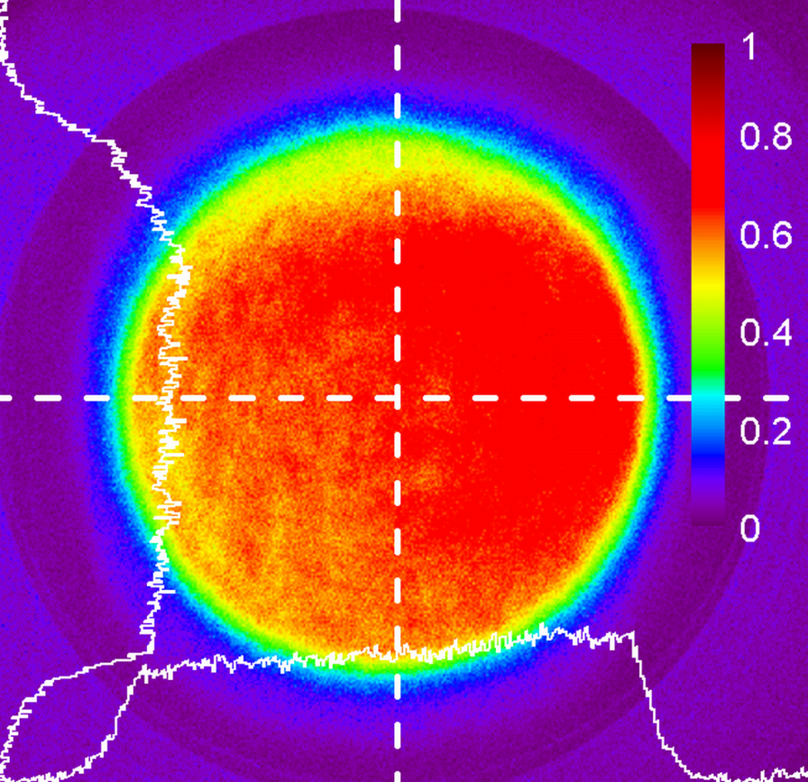
Fluorescence Image on Ti:sapphire Crystal
Total pump energy = 12 X 8 = 96 J, Pump beam diameter = 60 mm
Summing up the fluorescence images from 12 pump beams

Slide 17
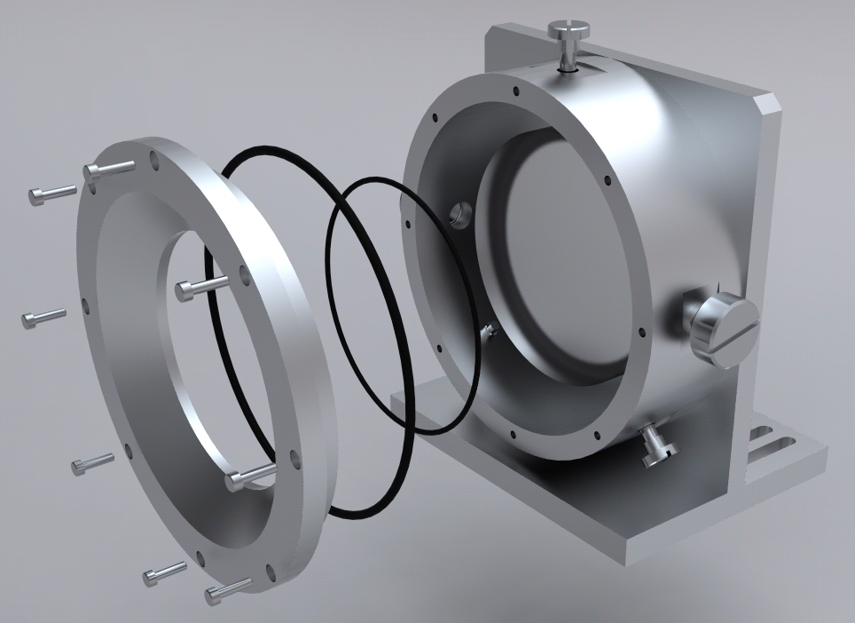
Suppression of Parasitic Lasing
Design of Ti:sapphire Crystal Mount
Control of Time Delay
Pump beam
IR seed beam
Index matching fluid + Absorption dye
- Di-iodomethabe derivative for IMF
(nominal index = 1.76)
- HITC-iodide for Laser dye
Precise Control of Time delay between Pump and IR seed beam

Slide 18
Spectrum in the booster amplifier
Spectral amplitude modulation
by AOPDF (Dazzler, Fastlite)
Gain narrowing
After amplification
Before amplification

Slide 19
Output Energy from Booster Amplifier
47 J
96 J
Experimental ( ) and calculated ( ) output energies (Frantz-Nodvic simulation)
Output energies measured at 0.1 Hz
E_{ave} = 46.3 J (0.53% RMS)

Slide 20
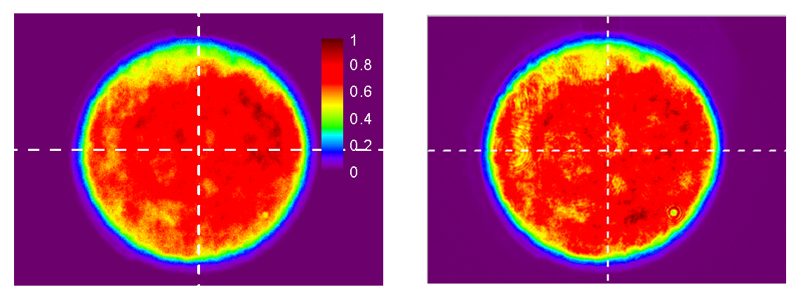
Spatial Beam Profile of Amplified Laser Pulse
Calculated intensity profile
(3D Frantz-Nodvic simulation)
Measured intensity profile
Calculated and Measured beam profiles show a very good similarity.

Slide 21
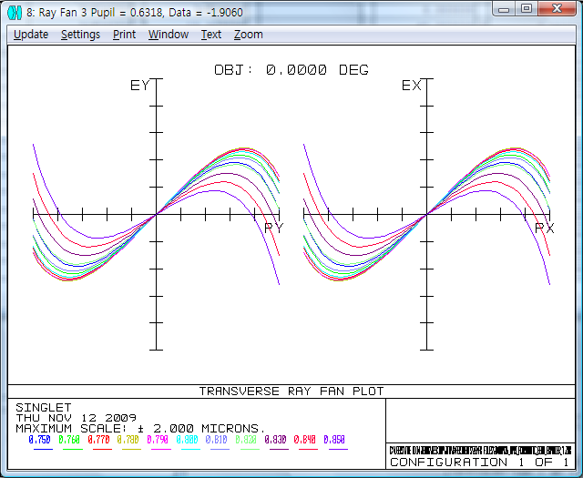
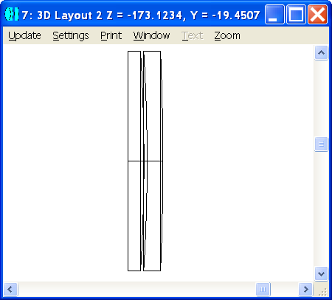
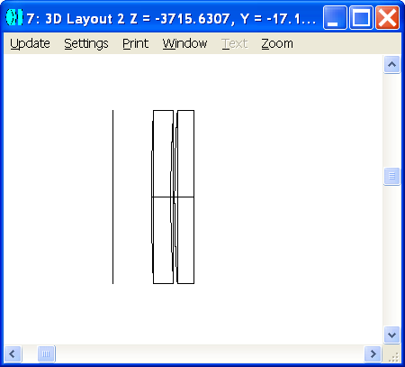
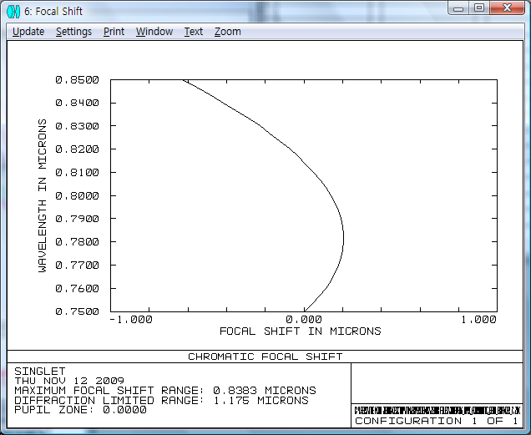
Achromatic Beam Expander
Simple Air-spaced SF6/BK7 beam expander
Ray fan vs wavelength
d2
2 um
2 um
d1
D1
D2
D3
D4
D5
Vacuum window
60 mm
200 mm
-2 um
-2 um
Focus shift vs wavelength
1245 mm
R1, R2, R3, R4
R5, R6, R7, R8
φ1 = 80 mm, φ2 = 240 mm
R1 = 426.3 mm, R2 = R3 = 289.4 mm, R4 = Inf.
R5 = Inf., R6 = R7 = -816.1 mm, R8 = -1216 mm
d1 = 1, d2 = 5 mm
D1 = D5 = 100, D2 = 20 mm, D3 = 4050.6 mm, D4 = 45 mm
-1 um
1 um

Slide 22
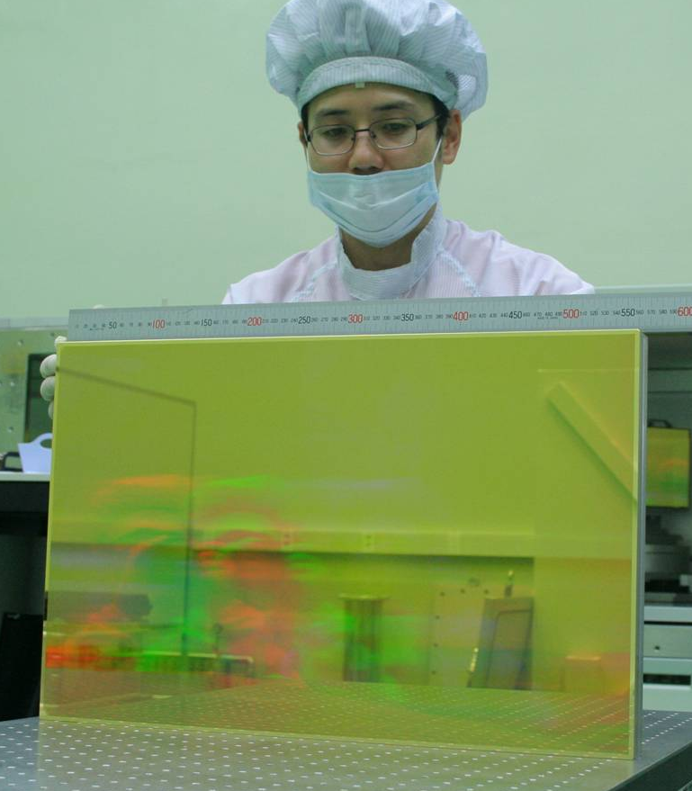
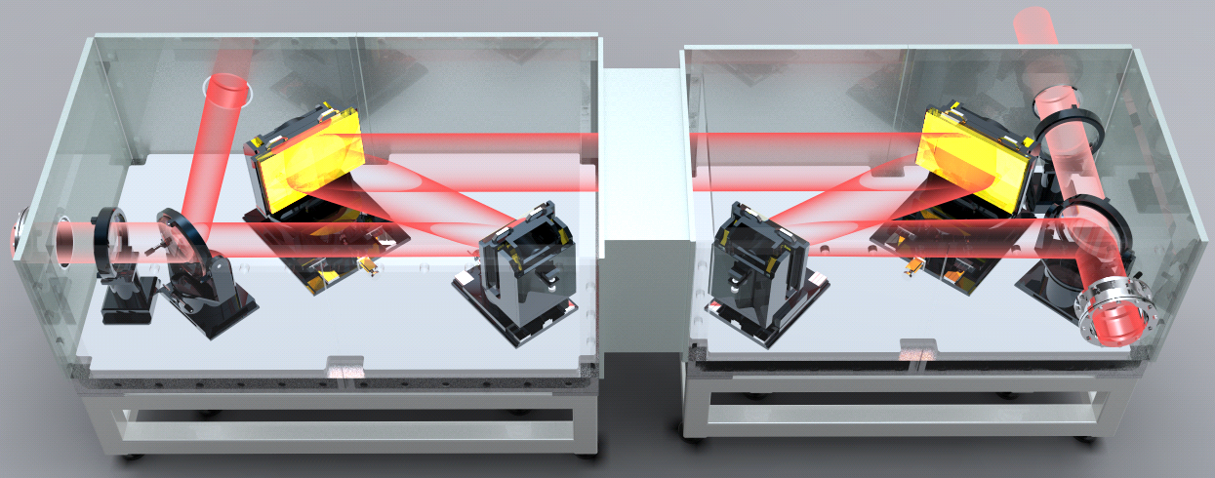
Four Gratings PW Compressor Chamber
Grating damage threshold
~150 mJ/cm²
Beam Diameter
200 mm
565 mm
1002 mm
Grating groove : 1480/mm
Incidence angle : 50.1 deg.

Slide 23
Pulse duration of compressed laser pulse
Measured spectrum and spectral phase
Reconstructed temporal profile
Intensity (A.U.)
ΔT = 30 fs
Time delay (fs)
For a tranform-limited pulse :
ΔT = 25 fs
Single Shot SPIDER technique used

Slide 24
Temporal contrast of PW laser pulse
Before Pumping in booster amplifier
After Pumping in booster amplifier

Slide 25
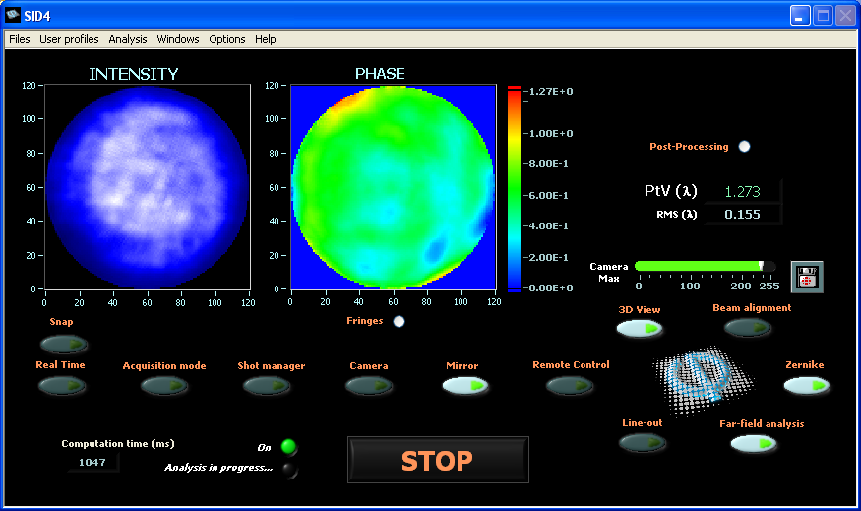
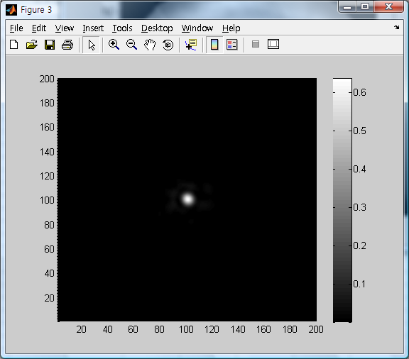
Measured wavefront and Focusability
Zernike decomposition
Measured wavefront after correction
200 mm
Wavefront height(in wavelength)
Focal spot
200 mm
(calculated, SR=0.65)
(Not measured yet)

Slide 26
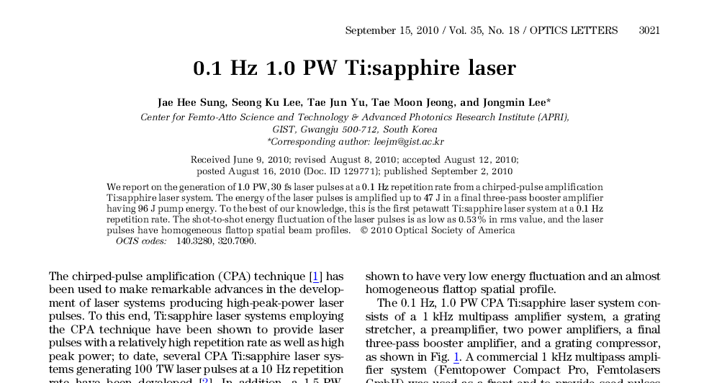
0.1-Hz, 1-PW CPA Ti:sapphire Laser System
First demonstration of 1 PW laser pulse from all Ti:sapphire-based laser

Slide 27
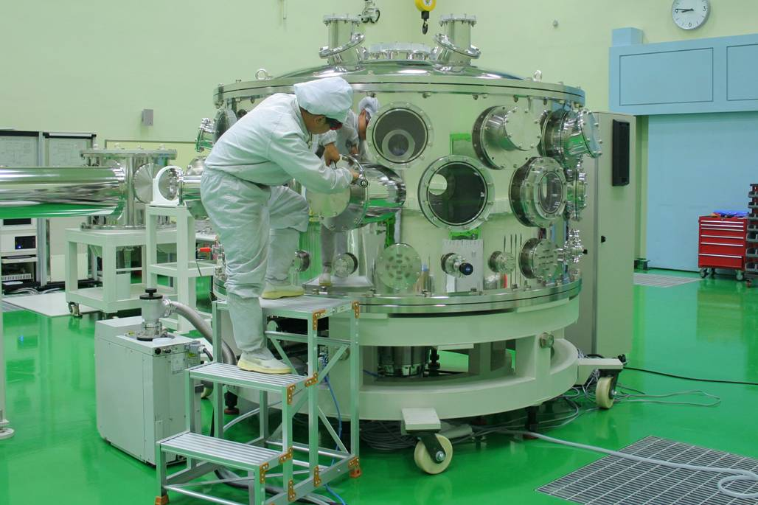
Beam Transport and PW Interaction Chamber
Optical layout
PW interaction chamber
PW
target chamber
2.2 m in dia.
Long focal-length
mirror chamber
PW
pulse compressor
PW beam
switching
chamber
Construction was completed
(under test)

Slide 28
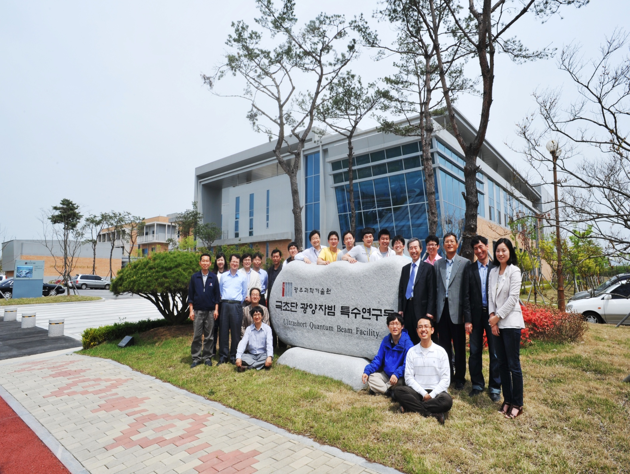
UQBF Members

Slide 29
Summary
◆ UQBF-1PW/B1 is successfully installed.
  Maximum Output Energy : 47 J at 96 J pump energy
  33 J after pulse compression
  Minimum Pulse Duration : 30 fs
  Maximum repetition rate : 0.1 Hz (1 shot/10 seconds)
  Beam diameter : ~ 200 mm
  Pulse energy stability : 0.53% rms
  Wavefront aberration and focusability : < 0.65 um in rms (for WA), 0.65 (for SR)
  Beam pointing stability : To be measured
  Temporal contrast : should be improved for applications
  ◆ UQBF-1PW/B2 will be completed in early 2011.
  ◆ UQBF(-100TW, -1PW/B1, and -1PW/B2) is a user facility.
  Please contact us at leejm@gist.ac.kr (Prof. J Lee) or jeongtm@gist.ac.kr (Tae Moon
  Jeong) for more information.

