Slide 1
Optical Signatures of Relativistic Transparency in Nanometer Foils
Rahul C. Shah,^{1,2} S. Palaniyappan¹, H-C. Wu¹, D. Gautier,¹ D. Jung,^{1,2} R. P. Johnson,¹ T. Shimada,¹ S. Letzring,¹ R. Hoerlein,³ , D. Kiefer,² D. Offermann,¹ L. Yin,¹ B. Albright, ¹ J. C. Fernández,¹ and B.M. Hegelich^{1,2}
¹Los Alamos National Laboratory (LANL) ²Ludwig-Maximilian-Universität(LMU) ³Max-Plank –Institut Fur Quantenoptik

Slide 2
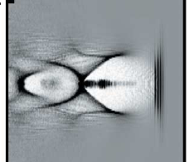
Relativistic optics: plasmas shorten and shape ultra-intense fs pulses
Light propagation depends on ratio of e⁻ density n_{e} to crit. density n_{c}
Underdense –e⁻ acceleration
n_{e} ~ 10⁻³ n_{c} << n_{c} , mm scale
Electron cavitation
Laser pulse
20 μm
Laser drives cavitation
Vel. of pulse front and rear different
40 fs pulse compressed to 10 fs
Faure et al. PRL 95: 205003 (2005); Faure et. al. Nature 431: 541 (2004)

Slide 3
Relativistic optics: plasmas shorten and shape ultra-intense fs pulses
Light propagation depends on ratio of e⁻ density n_{e} to crit. density n_{c}
Underdense –e⁻ acceleration
n_{e} ~ 10⁻³ n_{c} << n_{c} , mm scale
Overdense- ion acceleration
n_{e} ~ 700 n_{c} >> n_{c} , nm-µm scale
laser
Relativistic field a₀~10 (a₀ ~1, relativistic)
γ ~ a₀ ;n_{e} → n_{e} /γ & expansion
Transmitted pulse shortened and shaped with relativistic signatures
Electron cavitation
Laser pulse
20 μm
time
Shah et al in prep.; Palaniyappan et. al. in prep.
Laser drives cavitation
Vel. of pulse front and rear different
40 fs pulse compressed to 10 fs
Faure et al. PRL 95: 205003 (2005); Faure et. al. Nature 431: 541 (2004)
Earlier optical study:
Fuchs et al. PRL 80: 2326 (1998) – 30% transmission thru 2 µm, 50n_{c} ; Combination of hole-boring/expansion & rel. transparency
Particle based:
Willingale et. al. PRL 102: 25002 (2009) – proton energy from varying density foams consistent with rel. trans. & hole-boring)
Henig et. al. PRL 103: 045002 (2009) – proton energy linked to optimal onset of relativistic transparency
Hegelich et. al. submitted Nature Physics – new regime of ion acceleration from relativistically transparent targets (Theory papers by Yin, Yan and others)

Slide 4
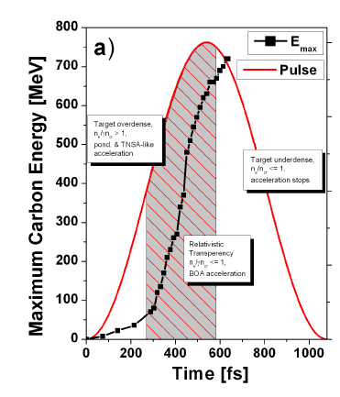
Relativistic transparency could play key role in development of laser-based particle and radiation sources
Laser-based ion acceleration
Thick target (μm’s): laser does not penetrate but drives electrons thru target which accelerate ions
Ultrathin foils allow laser to penetrate overdense plasma and extend acceleration process
Experiments & theory show relativistic transparency critical to energy gain (right shows result of simulation for 90 J, 540 fs laser driving ions from 58 nm foil [Talk of Hegelich; Hegelich et. al. submitted Nat. Phys.).
Laser pulse
n_{e}/γ=n_{c} rel. transparency
Peak C energy (arb. units-linear scale)
target underdense
n_{e}=n_{c} classical transparency
0
500
1000
Sharp rise time to drive second foil for ….
Time (fs)
transmitted pulse; 1D PIC (H-C Wu)
using existing LANL laser conditions
Increased ion energy?
initial foil
MeV, nm electron sheet
laser
Acceleration of nm electron sheets¹?
time snapshot from PIC
¹Meyter-vehn & Wu, EJPD: 55: 433 (2009)

Slide 5
Interactions with ultra-thin sheets of solid-density plasma require nano-foil technology and temporally clean light pulses
Diamond-like-carbon (DLC)
DLC coats tools, razors, engines
Amorphous structure improves strength (no fracture planes)
3-30 nm, mm aperture (asp. ratio 1E6)
fabricated by cathodic-arc-deposition
at LMU, Munich
arc cathode generates
ions from C target
collecting, focusing
duct
biased silicon substrate
DLC floated onto target stalk
Φ 0.5-1 mm

Slide 6
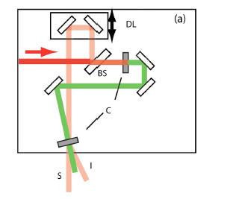
Interactions with ultra-thin sheets of solid-density plasma require nano-foil technology and temporally clean light pulses
Diamond-like-carbon (DLC)
DLC coats tools, razors, engines
Amorphous structure improves strength (no fracture planes)
3-30 nm, mm aperture (asp. ratio 1E6)
fabricated by cathodic-arc-deposition
at LMU, Munich
arc cathode generates
ions from C target
collecting, focusing
duct
biased silicon substrate
LMU, Munich
DLC floated onto target stalk
Φ 0.5-1 mm
Optical parametric amplification prepulse eliminator (OPAPE)
Peak intensity at 10²⁰ -10²¹ W/cm² ; damage at 10⁹ W/cm² at ns time scales
Amplified spontaneous emission proportional to gain stages
Remove ASE after initial 10 ⁷ gain using idler output of saturated OPA stage
poor contrast I/P
I _{2ω} (t) ~ I_{1ω}(t) ²
non linear crystals
high contrast idler
Wang and B.Luther-Davies JOSA B, 11: 1531 (1994); Shah et al Opt. Lett. 34: 2273 (2009); Johnson et al. In preparation.
~ I_{1ω}(t) ³

Slide 7
Interactions with ultra-thin sheets of solid-density plasma require nano-foil technology and temporally clean light pulses
Diamond-like-carbon (DLC)
DLC coats tools, razors, engines
Amorphous structure improves strength (no fracture planes)
3-30 nm, mm aperture (asp. ratio 1E6)
fabricated by cathodic-arc-deposition
at LMU, Munich
arc cathode generates
ions from C target
collecting, focusing
duct
biased silicon substrate
LMU, Munich
DLC floated onto target stalk
Φ 0.5-1 mm
Optical parametric amplification prepulse eliminator (OPAPE)
Peak intensity at 10²⁰ -10²¹ W/cm² ; damage at 10⁹ W/cm² at ns time scales
Amplified spontaneous emission proportional to gain stages
Remove ASE after initial 10 ⁷ gain using idler output of saturated OPA stage
After stretching and compressing:
better than 10 ⁻¹¹ at ns timescales based on damage studies
10⁻⁹ at 100 ps ; 10 ⁻⁷ at 10 ps
Now 10⁻⁹ at 50 ps
(from scanning measurements with low energy)
Wang and B.Luther-Davies JOSA B, 11: 1531 (1994); Shah et al Opt. Lett. 34: 2273 (2009); Johnson et al. In preparation.

Slide 8
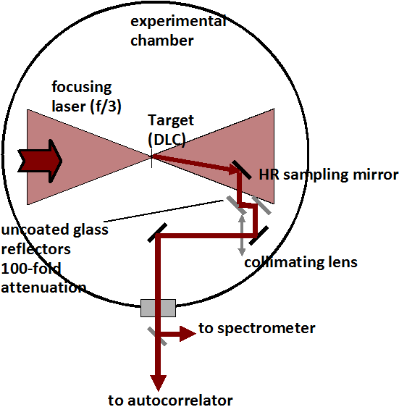
Setup for autocorrelation and spectral measurement of transmitted pulse
I_{pk} ~5 x10 ²⁰ W/cm² (Φ_{FWHM} =7 μm; 500 fs; 80 J on target with 10% in central 1 µm) ; γ_{fluid} ~ 20
Glass reflectors attenuate intensity to avoid non-linear effects
Beam collimated but not imaged
Autocorrelator aligned in front end and then single shot capable using apertures
Separate autocorrelator measures incident pulse

Slide 9
Autocorrelations show pulse shortening of transmitted pulse
5 nm
~4% efficiency in IR within 1” collection aperture
Vertically averaged
lineouts
17 nm
20 nm
Assuming Gaussian shape….
Target | I/P duration (fs) | O/P (fs) | Rel. change (%)
5 nm | 534 fs | 534±9 fs | 100±2 %
17 nm | 531 fs | 409 fs | 77 %
20 nm | 522 fs | 356 fs | 68 %
t

Slide 10
Spectra show non-transform-limited broadening, predominantly blue
77% AC narrowing;
~2.7 X BW; 4 nm centroid shift blue
Identical to I/P; 3 nm BW
68% AC narrowing;
~3X BW; 2 nm centroid shift blue
All data of Oct. 2009 run showed blue shift; April 2010 run predominantly blue shifts but some red shifts
Notes:
3 x original, 2-4 nm centroid

Slide 11
1D-PIC of transmission thru foils shows pulse shortening & spectral broadening with blue shift
temporal output
autocorrelation
I/P
transmitted pulse
63% narrowing
Calculated transmission time from analytical theory (Yan et. al. App. Phys. B. 98: 711)
spectrum
Simulation parameters
a₀ =10
30 nm, 700 n_{c} (DLC foil)
1D,3V simulation (VPIC
& Wu-PIC by HC Wu.)
50 nm shows 5.8 x
Δλ₀ and 15.7 nm shift with only later quarter of pulse transmitting
2.8 X Δλ₀
3.1 nm centroid shift blue

Slide 12
PIC shows blue-shift develops from light-speed target expansion
red shift
blue shift
Instantenous frequency shows blue shift occurs on tail of pulse
Originates from time varying optical phase

Slide 13
PIC shows blue-shift develops from light-speed target expansion
red shift
blue shift
Extracted <γ>, <n_{e}> within FWHM of density for fixed (gross) time-steps
Transparency when n_{e} =γ (i.e. n_{e}/γ=1)
γ initially grows similar to analytic expression
After transparency, γ significantly larger and integrative--suggestive of DLA due to dephasing of orbits¹
relativistic transparency
¹Meyer-ter-Vehn et. al. POP: 6: 641 (1999)

Slide 14
PIC shows blue-shift develops from light-speed target expansion
red shift
blue shift
Extremely rapid (v~0.3c) length expansion following transparency
Continued rise of γ and density drop rapidly brings n=(1-n_{e}/γ)^{1/2} to near constant value
~.005

Slide 15
PIC shows blue-shift develops from light-speed target expansion
red shift
blue shift
Early times, L small, dn/dt large gives red shift (not resolved in PIC extraction)
Quickly dL/dt dominates giving blue shift

Slide 16
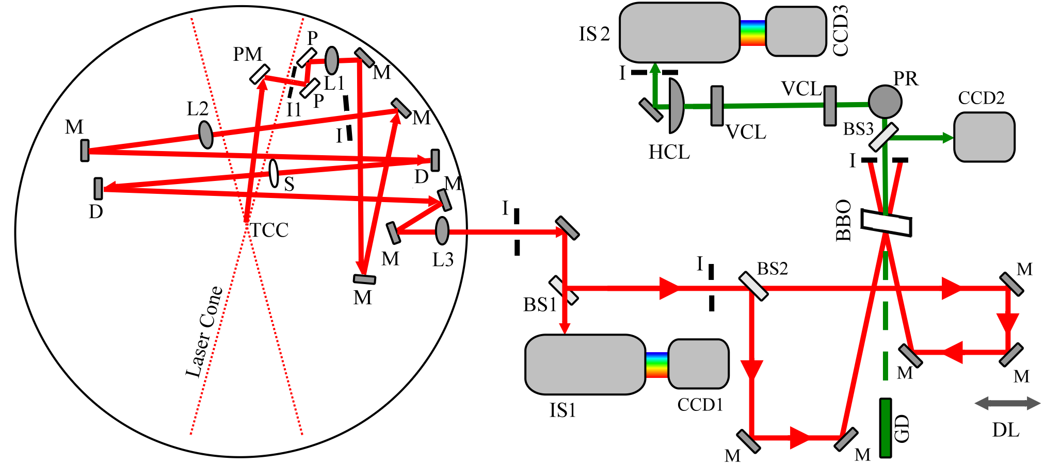
Experimental setup for pulse-shape measurement
imaging spectrometer (FROG)
folded telescope
w./ spatial filter
independent
spectrometer
Modified autocorrelation/spectrum setup to include telescope imaging and imaging spectrometer for FROG
autocorrelator
S. Palaniyappan, et al., Rev. Sci. Instrum. 81, 1 (2010)
Notes:
ok

Slide 17
Pulse-shape measurements
Null
5 nm
10 nm
Pulse shortening with assymmetric shape
5 nm shows variability (earlier data showed no shortening)
Time direction selected by placing blue chirp on trailing edge as seen in PIC
564 fs
387 fs
335 fs
Intensity
phase (rad)
time (ps)
3.2 nm
3.2 nm
5.1 nm
PSD
phase (rad)
λ (nm)
Notes:
Changes: Need oriented in way we believe agrees with PIC and latest thinking. Same scale for all spectra. .opj files directly in PPT so that scales can be adjusted to be readable.

Slide 18
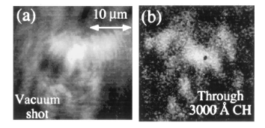
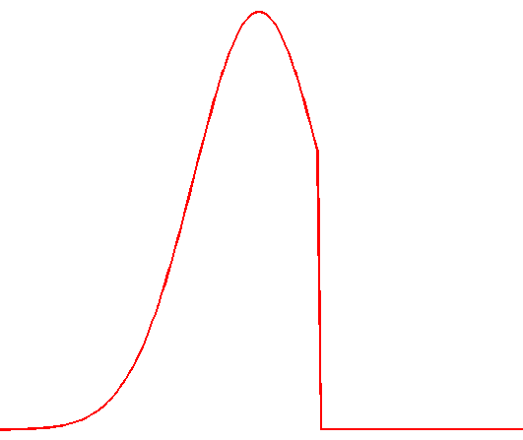
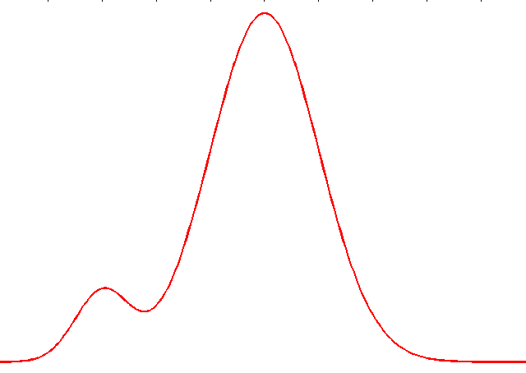
Diffraction Can Blur Sharp Rise and Distort Shape
Fuchs et al. PRL 80: 2326 (1998)
Focal plane
Observation
Diffraction
Vacuum
Thru 300 nm CH
Pulse imaged at focus
Fuchs et. al., observed that time integrated energy varied spatially across the focal plane-- non-linearly with input profile
Onset of transparency would be delayed in wings due to lower intensity and higher density
Observed pulse is Fraunhofer diffraction of pulses across the focal plane. Rise time lost at FROG device due to mixing of different pulses across the laser; with addition of time varying phase this also distorts pulse shape
Notes:
ok

Slide 19
Loss of Rise Time due to Diffraction
Idealized pulse immediately after foil
Propagated to detector
Radial positions (μm)
F.T. of each color
reconstruction of temporal profiles
Lineout
Lineout
Intensity (arb. units)
Time (ps)
Time (ps)
Spatial variation of transmission time results blurs sharp rise on propagation
Notes:
One like this, but with no phase, just showing mixing effects. If plots can be in opj I can adjust axis, here we only need I vs t, no phase

Slide 20
Pulse distortion due to diffraction when chirp included
Idealized pulse immediately after foil
Propagated to detector
Radial positions (μm)
F.T. of each color
reconstruction of temporal profiles
Chirp added
Lineout
Lineout
Intensity (arb. units)
Phase (rad)
Time (ps)
Time (ps)
Spatial variation of transmission time + chirp results in additional distortion
Notes:
One like this, but with phase showing scrambling effects. If plots can be in opj I can adjust axis, here we only need I vs t, no phase

Slide 21
Summary: Optical signatures of relativistic transparency in nm foils using high-contrast Trident Laser
Autocorrelation of transmitted light shows expected signature of pulse shortening due to induced transmission
Spectra show blue shifting consistent with simulation in which mechanism is traced to rapidly expanding target
Pulse shape measurements using FROG show asymmetric, shortened pulses consistent with propagation of spatially varying shaped pulses to detector
Use assumptions relating density with length & γ with intensity, to recover temporal evolution of density (n_{e} (t)) from measured inst. freq.
Approaches which eliminate diffractive effects to allow recovery of actual rise time for applications of shaped pulses

Slide 22
Extra slides

Slide 23
1D-PIC of transmission thru 30 nm and 50 nm foils shows pulse shortening & spectral broadening with blue shift
30 nm
Input intensity profile
Simulations run by Hui-chun Wu using VPIC and Wu-PIC
a
transmitted pulse
50 nm

Slide 24
Underdense target leaves intensity envelope unchanged and generates red and blue colors from self-phase-modulation
transmitted pulse
30 µm, 0.7 n_{c}
All pulse transmits, thus both rising and falling edges present and obtain red and blue colors
inst. freq.
transmitted spectrum
for underdense case
Spectrum broadens due to chirp of self-phase-modulation while temporal profile is unchanged.
Could we exploit this?

Slide 25
Additional slide

