Slide 1
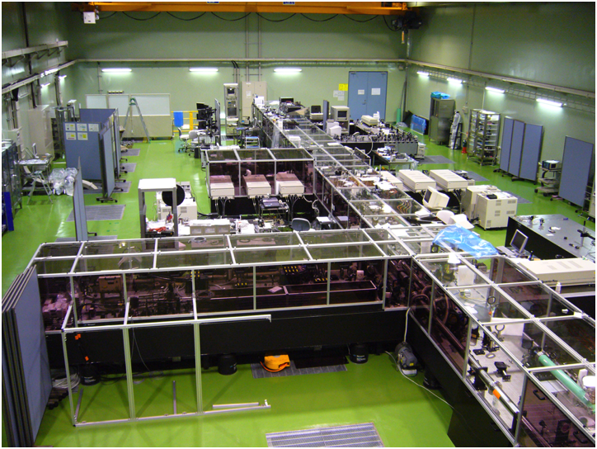
Demonstration of a High Spatiotemporal-Quality Petawatt-Class Ti:sapphire CPA laser system
Hiromitsu Kiriyama
Advanced Beam Technology Division (ABTD) and Photo-Medical Research Center (PMRC),
Japan Atomic Energy Agency (JAEA)
8-1-7 Umemidai, Kizugawa-city, Kyoto 619-0215, Japan
International Committee on Ultra Intense Lasers Conference (ICUIL) 2010
29 September, 2010
Harbor Hotel, Watkins Glen, New York, USA

Slide 2
Collaborators
M. Mori, Y. Nakai, T. Shimomura, H. Sasao, M. Tanaka, Y. Ochi, M. Tanoue, H. Okada, S. Kanazawa, I. Daito, D. Wakai, F. Sasao, M. Suzuki, A. Kosuge, M. Nishiuchi, S. Kondo, K. Kondo, A. Sugiyama, S. Bulanov, P. R. Bolton, H. Daido, A. Yokoyama, S. Kawanishi, and T. Tajima

Slide 3
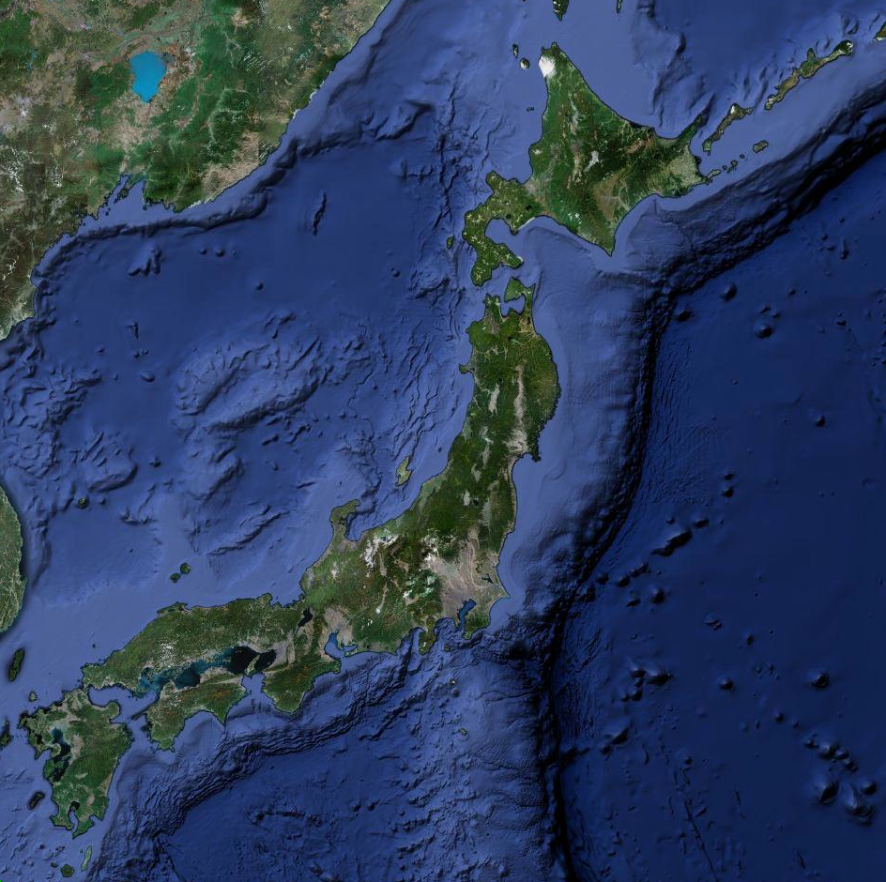
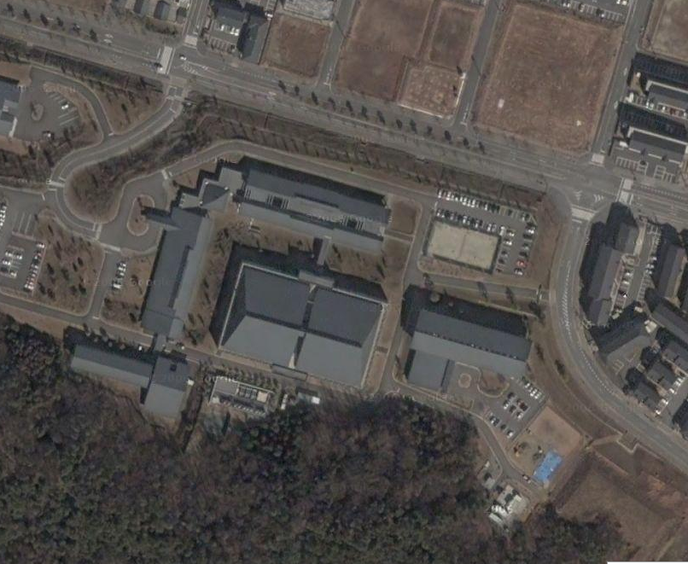
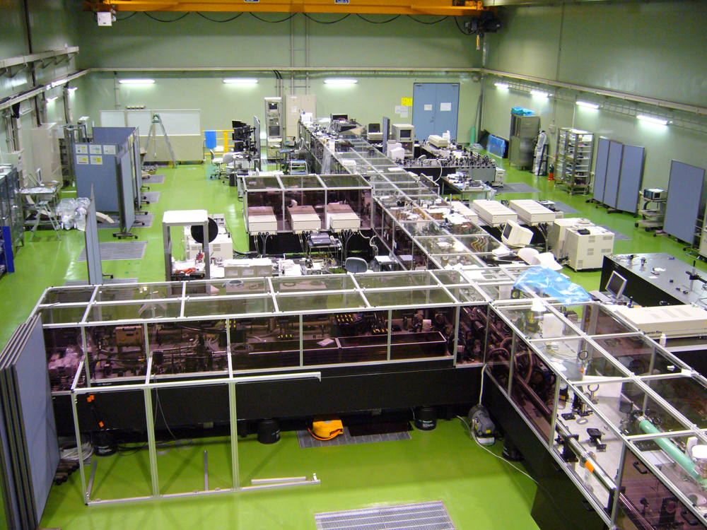
Kinkakuji-Temple
40 km
J-KAREN laser
Laboratory
Tokyo
Hawaii
7,000 km
Kyoto
Osaka
Todaiji-Temple
2 km

Slide 4
Outline
✓ Objective
✓ “J-KAREN” high intensity laser at ABTD, JAEA
✓ OPCPA preamplifier
✓ Cryogenic-cooled Ti:sapphire power amplifier
✓ Large-aperture Ti:sapphire final amplifier for petawatt power level
✓ Results on amplification, compression, and contrast performances
✓ Summary

Slide 5
Problem remains to be solved for the application of ultra-high intensity lasers in high-field physics
✓ Principal issue with high intensity laser experiments
Modern Ti:sapphire chirped-pulse amplification (CPA) lasers reach intensities greater than 10²⁰ W/cm². However, in the laser systems, a background of the amplified spontaneous emission (ASE) can generate unwanted plasmas before the main pulse arrives on the target.
10²⁰
Ideal pulse
10¹⁸
Experimental pulse
10¹⁶
ASE
Laser focused intensity [W/cm²]
10¹⁴
✓ Objective
10¹²
Plasma generation threshold
To generate >10¹⁰ temporal contrast, >10²⁰ W/cm² intensity laser pulses supporting petawatt power level.
10¹⁰
1
10
10²
10³
10⁴
10⁵
10⁶
10⁷
Time [fs]
Main subject

Slide 6
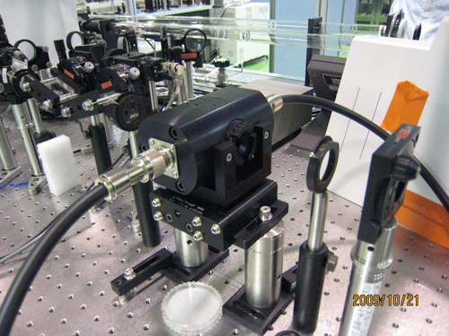
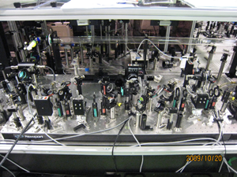
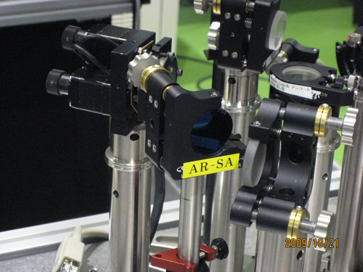
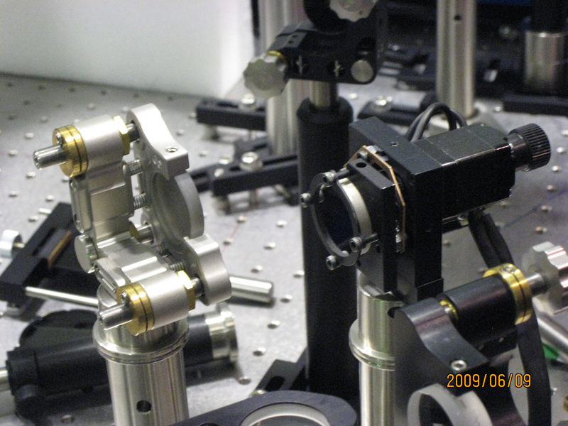
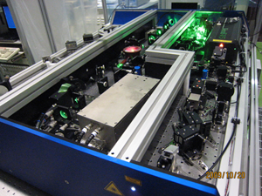
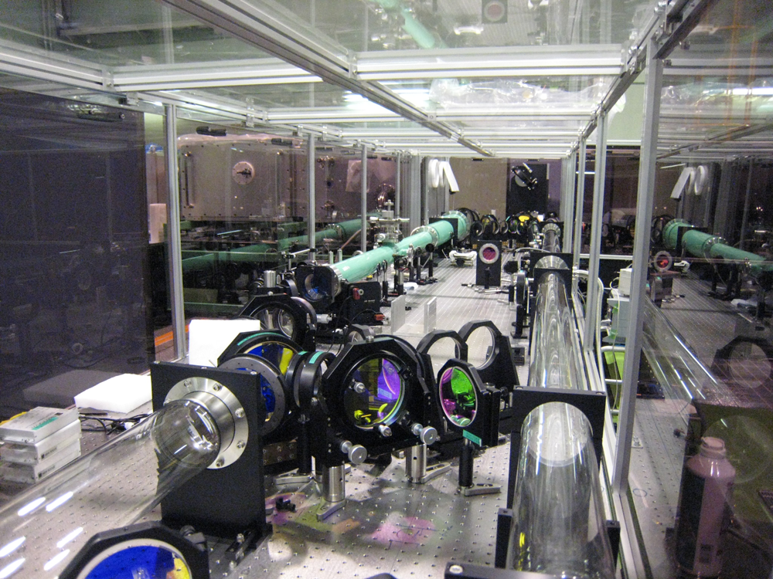
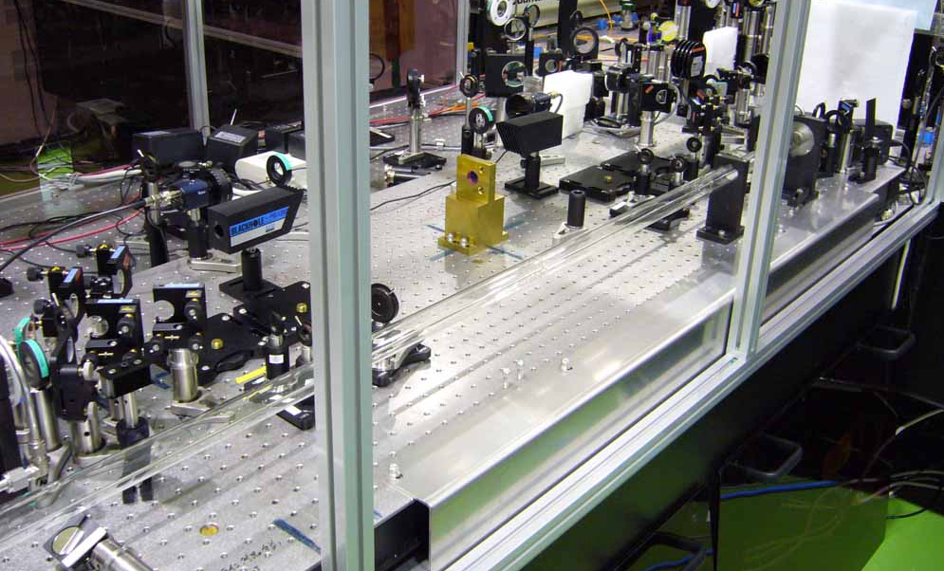
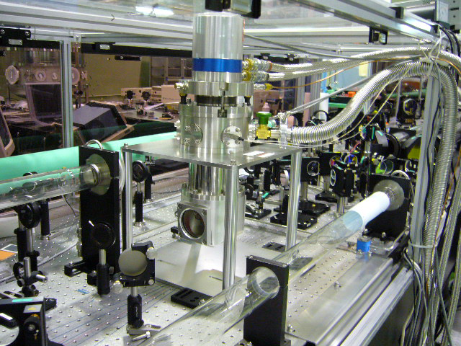
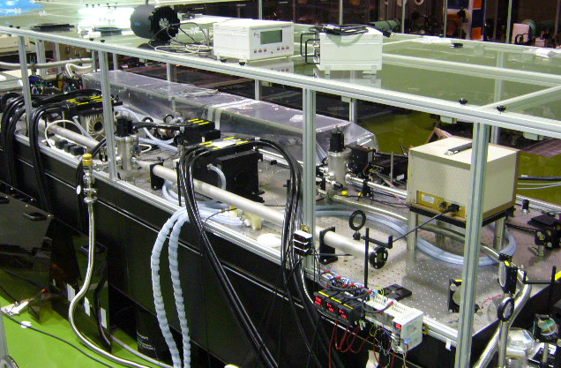
“J-KAREN” laser schematic
J-KAREN; JAEA Kansai Advanced Relativistic ENgineering
E=10 mJ
OPCPA preamplifier
2 x BBO
Stretcher
~30µJ, ~ns
Saturable
absorber
Ti:sapphire oscillator + preamplifier
First CPA
Ultra-fast
Pockels cell
Nd:YAG pump laser
0.2 J, 10 Hz
E=260 mJ
E=3.2 J
E=31 J
Ti:sapphire
preamplifier
cryogenic-cooled
Ti:sapphire power amplifier
Large-aperture Ti:sapphire
final amplifier
Compressor
64 %, 38 fs
Potential
P=>500TW
(38fs/20J)
Nd:YAG pump laser
0.8 J, 10 Hz
Nd:YAG pump laser
6.5 J, 10 Hz
Nd:Glass pump laser
61 J, Single-shot
SecondCPA
H. Kiriyama et al., Appl. Opt., 49 (2010) 2105.
H. Kiriyama et al., Opt. Lett, 35 (2010) 1497.

Slide 7
View of the J-KAREN laser system
Saturable
absorber
Ti:sapphire oscillator
+ preamplifier
Strecther
(~30µJ, ~ns)
OPCPA preamplifier
6 Nd:YAG pump lasers
(~6.5J, 10Hz)
Ti:sap. preamplifier
Cryogenic-cooled Ti:sap. power amplifier
(3.2J, 10Hz)
Compressor
(1.7J, 30fs, ~60TW, 10Hz, >10¹⁰)
Nd:glass pump lasers
(~60J, Single-shot)
Compressor
(20J, 38fs, >500TW)
Large-aperture Ti:sap. final amplifier
(31J, Single-shot)

Slide 8
Optical Parametric Chirped-Pulse Amplification (OPCPA) concept
J. Collier et., ICUIL2010 MO1.
OPCPA
✓ Uses a monochromatic laser to provide
broadband amplification
OPCPA =
✓ Relies on frequency mixing (OPA) in a
nonlinear crystal to provide the energy
transfer mechanism
Chirped-Pulse Amplification (CPA)
+
Optical Parametric Amplification (OPA)
A. Dubietis et al., Opt. Commun., 88 (1992) 437.
I. N. Ross et al., Opt. Commun., 144 (1997) 125.
Pump beam
Amplified signal
Depleted pump
Idler beam
Signal beam
Nonlinear crystal

Slide 9
Advantages of OPCPA properties
✓ Good contrast
(eg. direct energy transfer, shorter ASE duration)
✓ Broad bandwidth
(eg. >100-nm )
✓ High gain (eg. 10^{xx}) in a short material length (cm’s)
(eg. 10^{xx} in cm’s)
✓ Excellent beam quality
(eg. no thermal loaging)
✓ Scalable…….
(eg. large nonlinear crystal, directional gain)

Slide 10
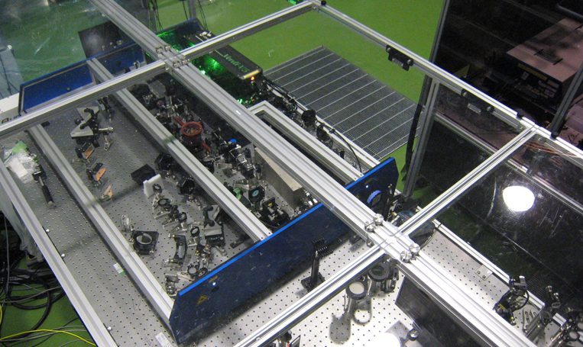
First CPA can produce cleaned high-energy (~30µJ) seed pulse for injecting into second CPA
Oscillator
First CPA
Preamplifier
Femtolasers Produktions GmbH
Stretcher
Compressor
Saturable
absorber
Stretcher
(~30µJ, ~ns)
We use double CPA architecture to enhance the contrast
M. P. Kalashnikov et al., Opt. Lett., 30 (2005) 923.

Slide 11
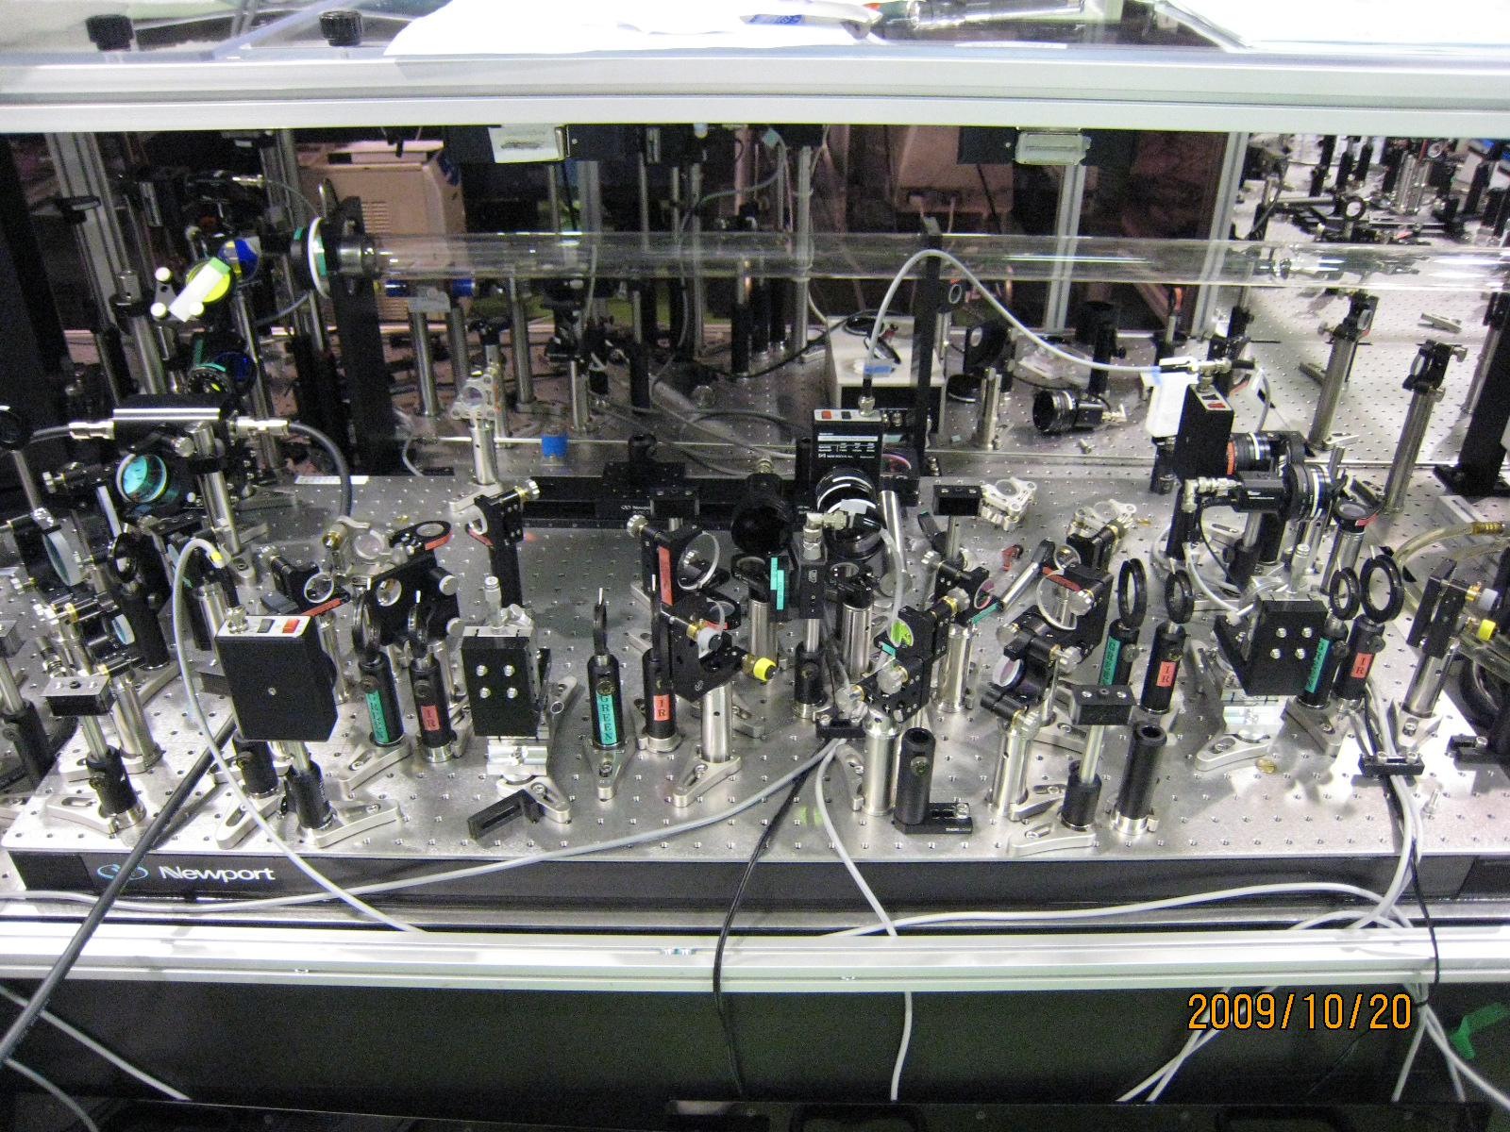
OPCPA technique is used as a high-contrast and broad band preamplifier
Pump pulse
Seed pulse
~20cm
~60cm
First amp.
(BBO)
Second amp.
(BBO)

Slide 12
Our OPCPA provides a maximum gain of only ~3 x 10² and achieves spectral control from 38-nm (FWHM) to 51-nm (FWHM)
✓ Gain
✓ Spectrum
~3 x 10²
38-nm before OPCPA
10³
1.2
51-nm after OPCPA
1
10²
0.8
Gain
Intensity [a.u.]
0.6
10
0.4
0.2
1
0
0
50
100
150
200
250
760
770
780
790
800
810
820
830
840
Pump energy [mJ]
Wavelength [nm]
We use low-gain OPCPA to enhance the contrast
H. Kiriyama et al., Opt. Lett., 32 (2007) 2315.

Slide 13
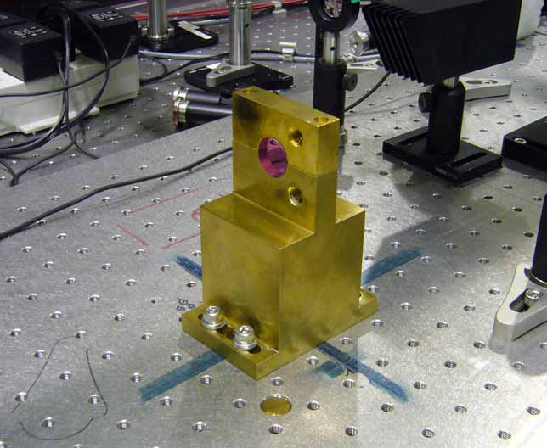
Signal pulse from OPCPA system is amplified to 280 mJ in 4-pass Ti:sapphire preamplifier
✓ View of Ti:sapphire preamplifier
✓ Extraction energy
280 mJ
300
Signal pulse
250
200
Output energy [mJ]
150
100
Pump pulse
20 mm diameter Ti:sapphire crystal
50
0
0
200
400
600
800
1000
Incident pump energy [mJ]

Slide 14
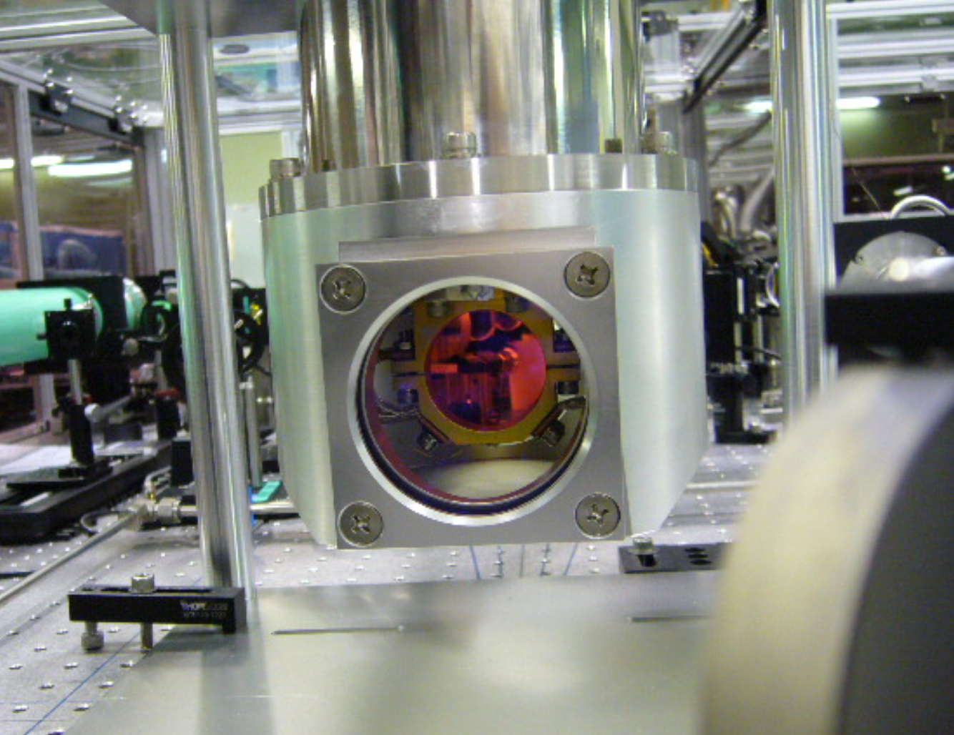
Using a 4-pass cryogenic-cooled Ti:sapphire power amplifier, we amplify further to 3.2 J
✓ View of Ti:sapphire power amplifier
✓ Extraction energy
3.2 J
3.5
3
2.5
Pump pulse
2
Output energy [J]
1.5
Signal pulse
40 mm diameter Ti:sapphire crystal
1
0.5
We cool the Ti:sapphire crystal in power amplifier down to below 100 K, in order to increase its thermal conductivity while reducing the dn/dt, for negligible thermal focusing
0
0
1
2
3
4
5
6
7
Incident pump energy [J]

Slide 15
Our frequency-doubled glass pump laser generates green pulse energy of 96 J
✓ View of high-energy glass pump laser
✓ Output green energy
96 J
100
80
60
Second-harmonic output energy [J]
5.0 m
40
1.2 m
20
0
0
50
100
150
200
Fundamental energy [J]

Slide 16
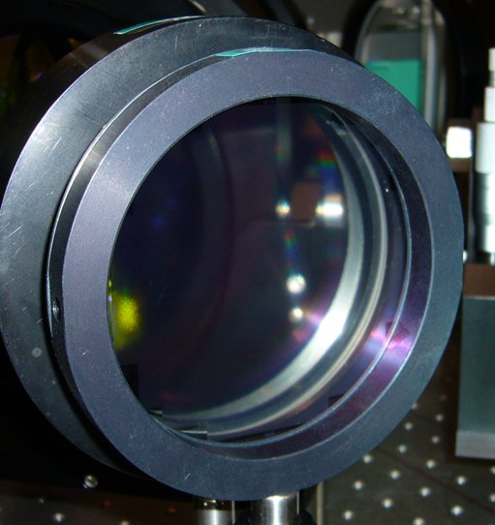
We use diffractive optical elements (DOE) for beam homogenization of 100-J level high-energy green laser
✓ View of beam homogenizer
✓ Working principle of diffractive homogenizer
Far Field
Homogenization is obtained with the sum of the N*N sub-elements contributions
80-mmΦ
Green beam
Diffractive homogenizer
K Ertel et al., Opt. Exp., 16 (2008) 8039.
Courtesy of SILIOS Technologies

Slide 17
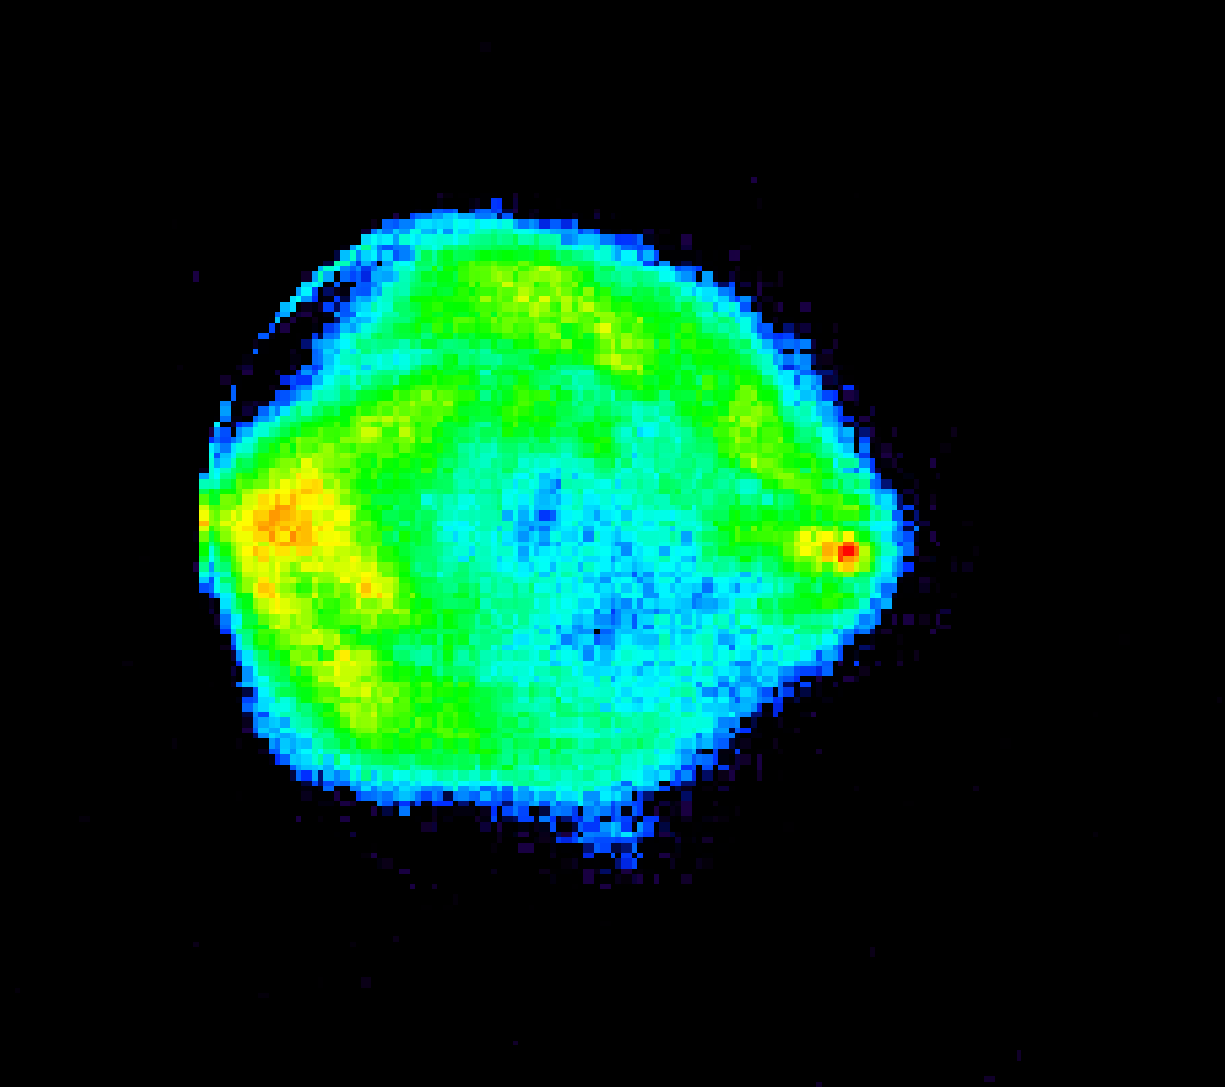
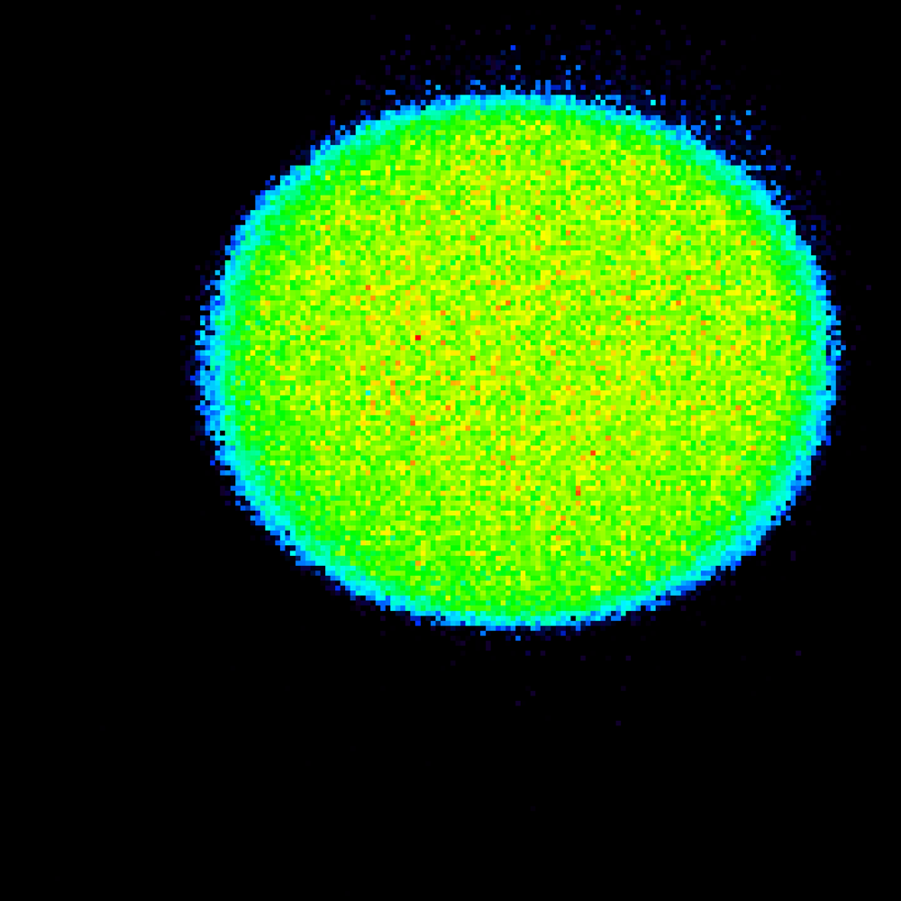
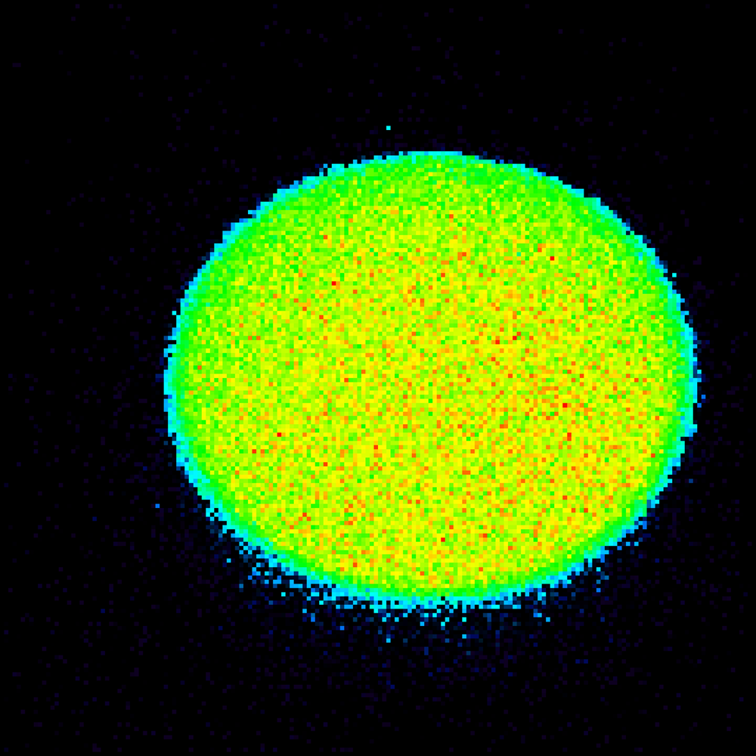
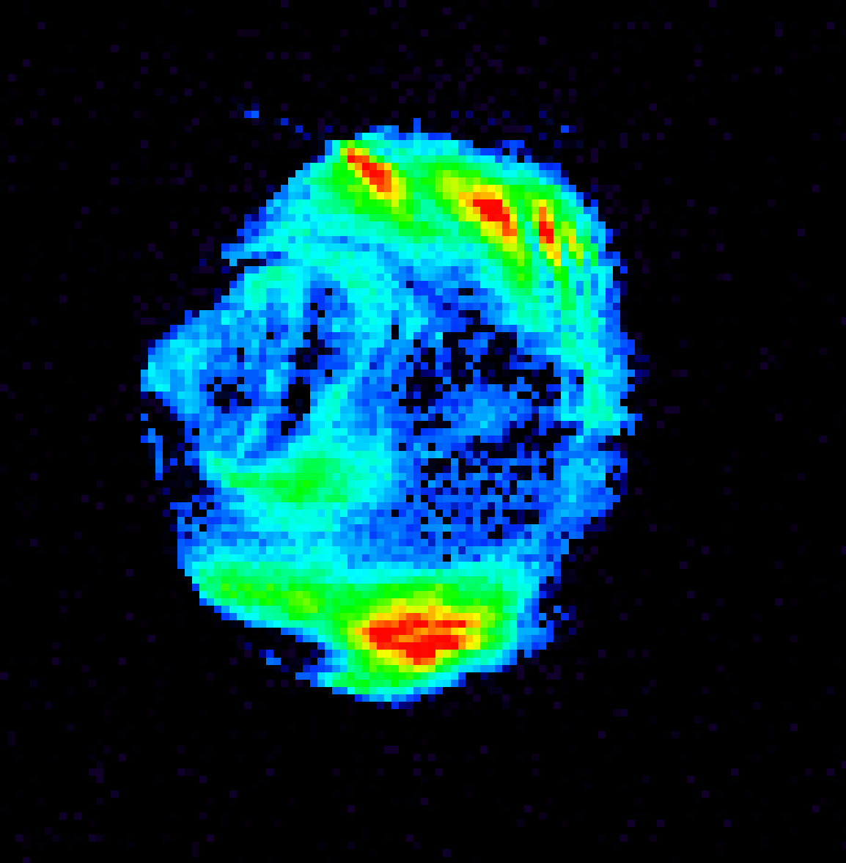
We have successfully generated near-perfect top-hat-like green beam intensity distributions
✓ Without homogenizer
✓ With homogenizer
First frequency doubler
In plane of Ti:sapphire crystal
Second frequency doubler
In other plane of Ti:sapphire crystal
M. Tanaka et al., Opt. Commun., 282 (2009) 4401.

Slide 18
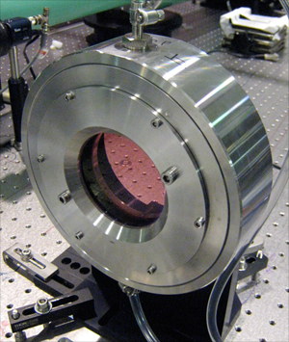
Large-aperture 3-pass final amplifier brings the energy over 30 J
✓ View of Ti:sapphire final amplifier
✓ Extraction energy
31 J
35
To compressor
thermoplastic polymer cladding
30
Index-matching liquid cladding
Theoretical curve
25
Signal pulse
20
Output energy [J]
15
10
Pump pulse
5
0
0
10
20
30
40
50
60
70
Incident pump energy [J]
80 mm diameter Ti:sapphire crystal
Liquid consists of diiodomethane, sulfur and tin iodide.
Liquid contains a broadband absorbing dye.

Slide 19
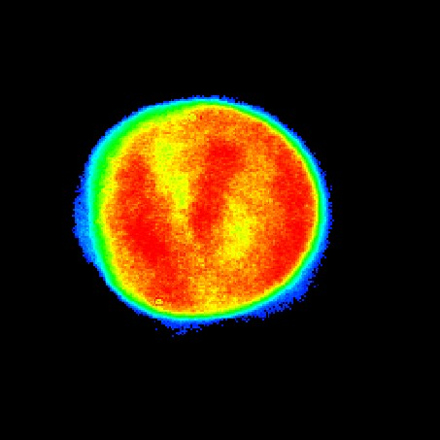
Spatial profiles of 30 J broadband laser pulse have also near homogeneous flat-top intensity distributions. Pulse duration without pumping the final amplifier is 38 fs, indicating the potential for peak power of greater than 500 TW
✓ Near-field spatial profile of 30 J pulse
✓ Pulse width
1.2
1.0
0.8
Intensity [a.u.]
0.6
0.4
38 fs (FWHM)
0.2
0
-400
-200
0
200
400
Filing factor is ~0.8
Delay [fs]
H. Kiriyama et al., Appl. Opt., 49 (2010) 2105.
Potential peak power is >500 TW (38 fs/20 J)

Slide 20
For the compressed pulse without pumping the final amplifier we found that the temporal contrast exceeds 10⁻¹¹
The peak will increase
1
with pumping the final amplifier
(~10J level)
10⁻²
10⁻⁴
Regenerative amp.
5 x 10⁻⁶
10⁻⁶
Intensity [a.u.]
OPCPA (nJ-seed)
Contrast with pumping the final
amplifier should be < 2.8 x 10⁻¹¹ !
10⁻⁸
7 x 10⁻⁹
<5 x 10⁻¹¹
(detection limited)
10⁻¹⁰
OPCPA (30µJ-seed)
<1 x 10⁻¹¹
(detection limited)
10⁻¹²
-500
-400
-300
-200
-100
0
100
The background
will decrease
Delay [ps]
H. Kiriyama et al., Opt. Lett, 35 (2010) 1497.

Slide 21
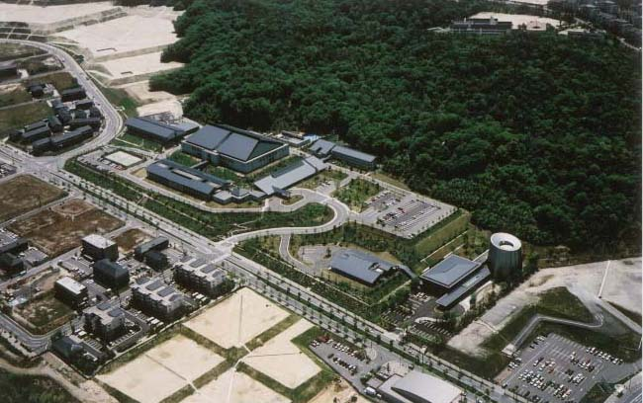
Conclusions
✓ Obtained ~10¹¹ temporal contrast with near-perfect top-hat-like
intensity distribution
✓ Indicated potential for achieving peak powers in excess of 500 TW
✓ Very encouraged by the positive results
✓ Currently supplying to laser-plasma accelerator experiments
J-KAREN Laser of TODAY
Petawatt-class peak power with ~10¹¹ temporal contrast

Slide 22
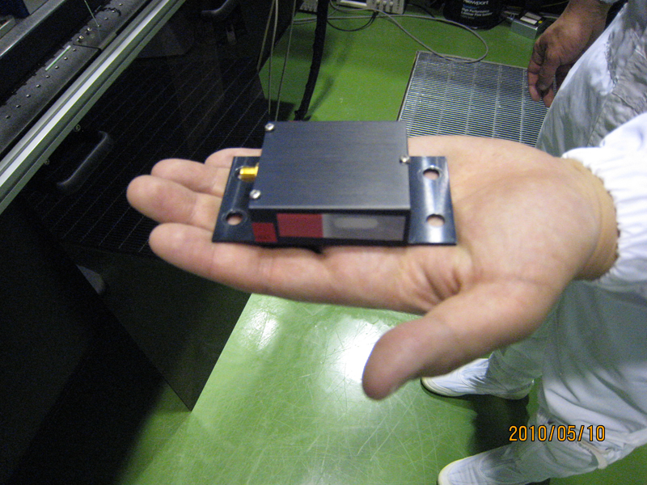
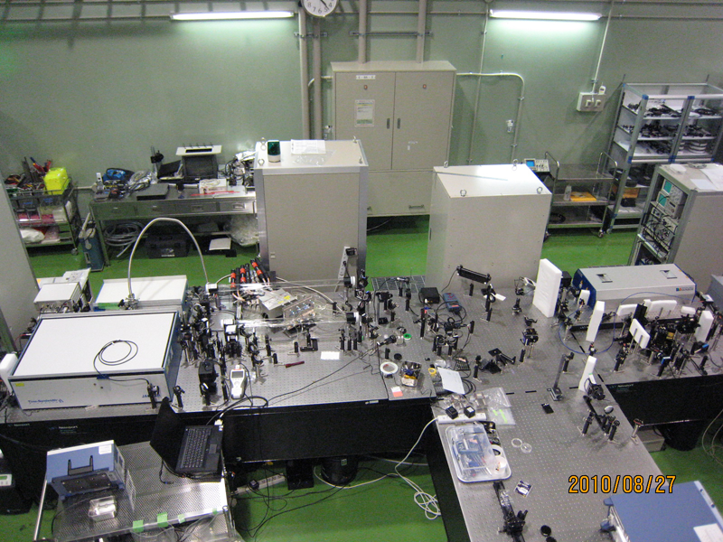
Tomorrow?
✓ To generate a shorter pulse
( October, 2010)
AOPDF
Acousto-Optic Programmable Dispersive Filter
OPCPA with short pump pulse as FIRST-CPA
✓ To generate a higher contrast,
shorter pulse
(Spring, 2011)
High energy, short pulse pump laser
Ultra-short pulse OPCPA laser

Slide 23
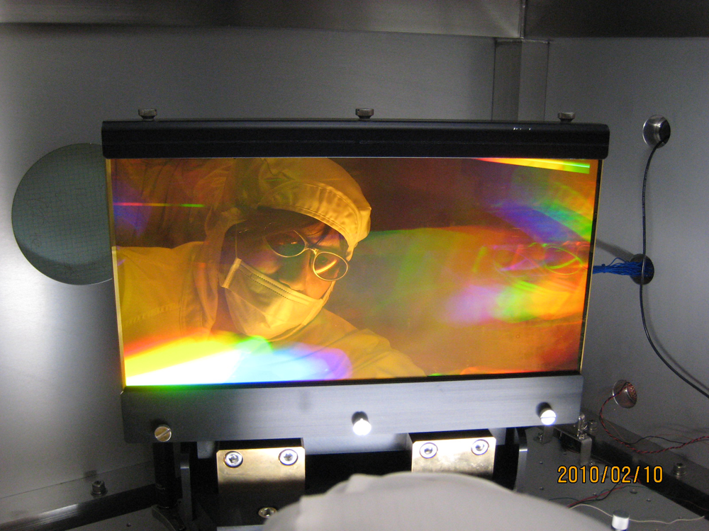
Thank you very much for listening !
Thank you very much !!
Questions?

