Slide 1



Ultrafast Dynamics in
Solid Plasmas Using
Doppler Spectrometry and
Giant magnetic Pulses
Amit D. Lad
Ultrashort Pulse High Intensity Laser Laboratory (UPHILL)
Tata Institute of Fundamental Research,
Mumbai – 400005
www. tifr.res.in/~uphill

Slide 2
Collaborators
S. Mondal, V. Narayanan, Gourab Chatterjee, Prashant Singh, S. N. Ahmed,
Tata Institute of Fundamental Research, Mumbai, India
P. P. Rajeev and A. Robinson
Central Laser Facility, Rutherford-Appleton Laboratory, U. K.
J. Pasley
Department of Physics, University of York, Heslington, U. K.
S. Sengupta, A. Das, and P. K. Kaw
Institute of Plasma Research, , Bhat, Gandhinagar, India
W. M. Wang, Z. M. Sheng
Institute of Physics, CAS and SJT University, P. R. China
R. Rajeev, M. Krishnamurthy, and G. Ravindra Kumar
Attending
ICUIL 2010

Slide 3
Laser Plasma Interaction
Plasma
Intensity : 10¹⁹ W/cm²
Laser τ : 30 X 10⁻¹⁵ s
Plasma T : 10² / 10⁵ eV
Plasma Velocity : 10⁷ -10⁸ cm/s
Target
Laser
Heat
Transport
Scattered Light
n_{cr}
Laser
Fast
Particles
Scattered Light
X-rays

Slide 4
Topic 1
Dynamics of plasma critical surface
Topic 2
Hot electron propagation inside dense plasma
Notes:
4

Slide 5
Topic 1
Dynamics of plasma critical surface
Topic 2
Hot electron propagation inside dense plasma
Notes:
5

Slide 6
Motivation
To Estimate
the Plasma Expansion Velocity and
thereby
the Instantaneous Plasma Profile
6

Slide 7
Ultrafast Plasma Dynamics
Plasma motion occurs at very high velocity
(> 10⁷ cm/sec)
So plasma profile changes rapidly
This implies, plasma conditions change significantly during laser interactions

Slide 8
Capturing Plasma Motion “as it happens”
800 nm, 30 fs
Spot : 17 μm
5 x 10¹⁸ W/cm²
Pump-Probe Experiment
P-polarized
Laser Pump
Spectrometer
400 nm, 80 fs
Spot : 60 µm
~10¹² W/cm²
Probe
(Time Delayed
w. r. t. Pump :
0 to 30 ps)
Target :
Aluminium
Probe Pulse Experiences Doppler Shift
Notes:
8

Slide 9
Doppler –Shift Experimental
Set Up
Bending Mirror
PUMP Laser (800 nm)
Pump Laser (800 nm)
5% BS
Target
Off-Axis Parabolic Mirror for Focusing
UV-Visible
High Resolution Spectrometer
Probe Laser
400 nm
2ω Crystal
50% BS
Delay Stage
UV-Visible Spectrometer
Notes:
9

Slide 10
Laser Pulse Shape
For 400 nm : Δλ = 3 nm at 80 fs
For 800 nm : Δλ = 34 nm at 30 fs
Second
Harmonic
(2ω)
3 nm
Fundamental
(ω)
34 nm
Sharp 2ω profile makes it easier to see small
spectral changes

Slide 11
Doppler Shift
3x10¹⁸ W/cm²
800 nm
30 fs
Spectrometer
P-polarized
Laser Pump
Spectrometer
~10¹² W/cm²
400 nm
80 fs
10¹⁷ W/cm²
800 nm
2 ps
Target :
Aluminium
Target :
Aluminium
0 to 30 ps
TIFR Expt.: Mondal et al.,
PRL 105, 105002 (2010)
Kalashnikov, PRL 73, 260 (1994).

Slide 12
Time Delayed Spectra
Target :
Aluminium

Slide 13
Time Delayed Spectra
Target :
Aluminium

Slide 14
To Observe Small Shifts it is Better to
Observe Differences
i.e.
Time Delayed Probe Spectrum – Reference Probe Spectrum

Slide 15
If the time delayed spectrum is red-shifted with respect to zero time delayed spectrum : subtracted spectrum (later spectrum - zero time delay spectrum) will show minima followed by maxima

Slide 16
If the time delayed spectrum is blue-shifted with respect to zero time delayed spectrum : subtracted spectrum (later spectrum-zero time delay spectrum) will show maxima followed by minima

Slide 17
Dynamics Over Time Scale of 30 ps
Mondal et al.,
PRL 105, 105002 (2010)

Slide 18
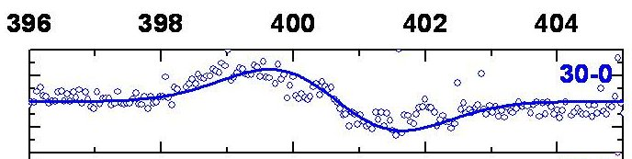
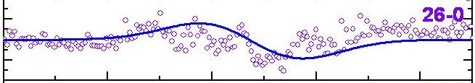
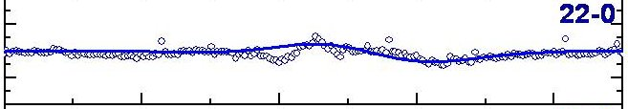
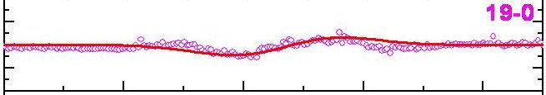
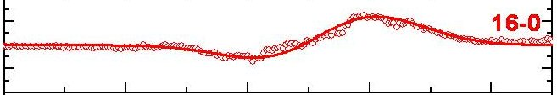
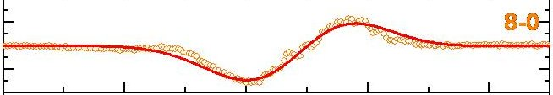
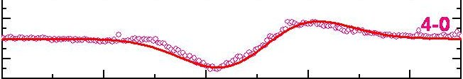
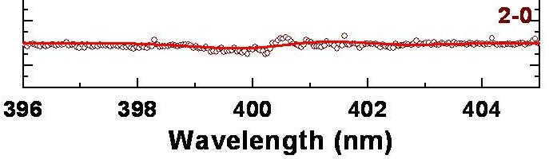
Dynamics Over Time Scale of 30 ps
Critical Surface is
Expanding towards
the probe beam
Blue-shift
Reversal of difference probe spectra (from red to blue shift)
Red-shift
Critical Surface is
Receding from
the probe beam
Probe
t (ps)
Pump
0
15
30

Slide 19
Doppler Shift
Why Red Shift ???
The pump laser launches a compression wave into front surface plasma
At early times compression wave forces the critical surface into the target

Slide 20
Doppler Shift
Why Blue Shift ???
At later times a compression wave has propagated into
a region of overdense plasma
Critical surface of the probe sits in the region that is undergoing rarefaction,
thus critical surface is moving into the vacuum and towards the laser

Slide 21
Doppler Shift in Reflected Probe Spectra
Pump:
800 nm,
3 x 10¹⁸ W/cm²
A polynomial fit
Red-shift
Blue-shift
Probe:
400 nm
Target :
Aluminium
Mondal et al.,
PRL 105, 105002 (2010)

Slide 22
Velocity and Acceleration from Doppler Shift
Instantaneous
Velocity
Acceleration
Critical surface moves (expanding)
AWAY from the target
Critical surface move
INTO the target
Mondal et al.,
PRL 105, 105002 (2010)
V_{expansion} = 0.5v (λ/Δλ) (cos θ)

Slide 23
Doppler Shift : Simulations
1D PIC + 1D Hydrodynamic (HYADES) Simulations
Results of PIC simulation as a input of HYADES
500 µm Al target : 100 Lagrangian cells
Two different Laser Sources : 800 nm and 400 nm
Red line is 800 nm pump profile
Blue line is 400 nm probe profile
Pump main pulse is 30 fs flat top
Probe is 80 fs flat top

Slide 24
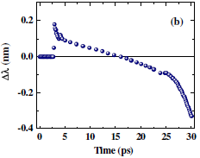
Doppler Shift in Reflected Probe Spectra
Pump:
λ = 800 nm
Probe:
λ = 400 nm
Red-shift
Blue-shift
Mondal et al.,
PRL 105, 105002 (2010)
Target :
Aluminium

Slide 25
TOPIC 2
HOT Electrons Transport -------
GIANT magnetic fields

Slide 26
Polarimetry
Pump-Probe Experiment
Target
Al coated glass
P-polarized
Laser Pump
800 nm, 30 fs
To Polarimeter
Probe
(Time Delayed
w. r. t. Pump)
Hot electron currents,
Giant magnetic fields,
Plasma motion…….
400 nm
Principle: Probe polarization changes due to magnetic field created by pump
TIFR + IPR
Phys. Rev. Lett. 89 225002 (2002), PRE (2006); POP (2009).
Notes:
26

Slide 27
Polarimetry
Pump-Probe Experiment
Detectors
PD: Integrated
CCD: Spatial resolution
P-polarized
Laser Pump
800 nm, 30 fs
To Polarimeter
Probe
(Time Delayed
w. r. t. Pump)
Hot electron currents,
Giant magnetic fields,
Plasma motion…….
Target :
100 µm thin Fused Silica
800 nm
Principle: Probe polarization changes due to magnetic field created by pump
Notes:
27

Slide 28
Measured Magnetic Field of Relativistic Electrons
Giant, Ultrashort Magnetic Pulse !
Aluminium coated glass
100 µm Fused silica
Target Front
Target Back
Mondal et al.,
(manuscript under preparation)
5 x 10¹⁸ W cm⁻²
2 x 10¹⁸ W cm⁻²

Slide 29
Relativistic Electron Transport
‘Hot electron’ currents and ‘Cold return’ currents interact with each other
Currents become unstable (Weibel instability- B dependent)
Electron beam breaks up into filaments
Magnetic field gets localized and inhomogeneous
Direct Evidence?

Slide 30
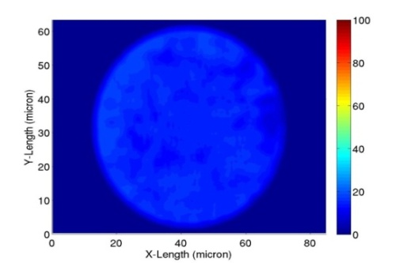
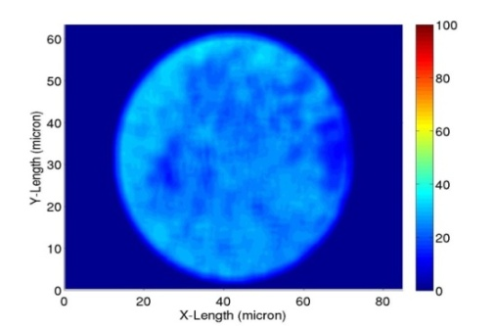
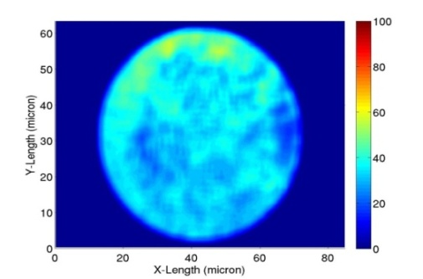
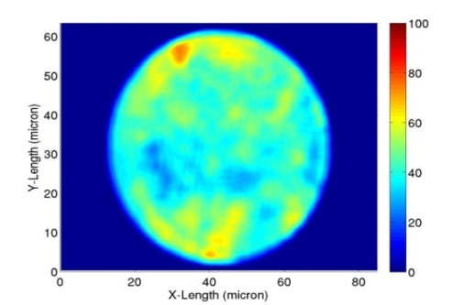
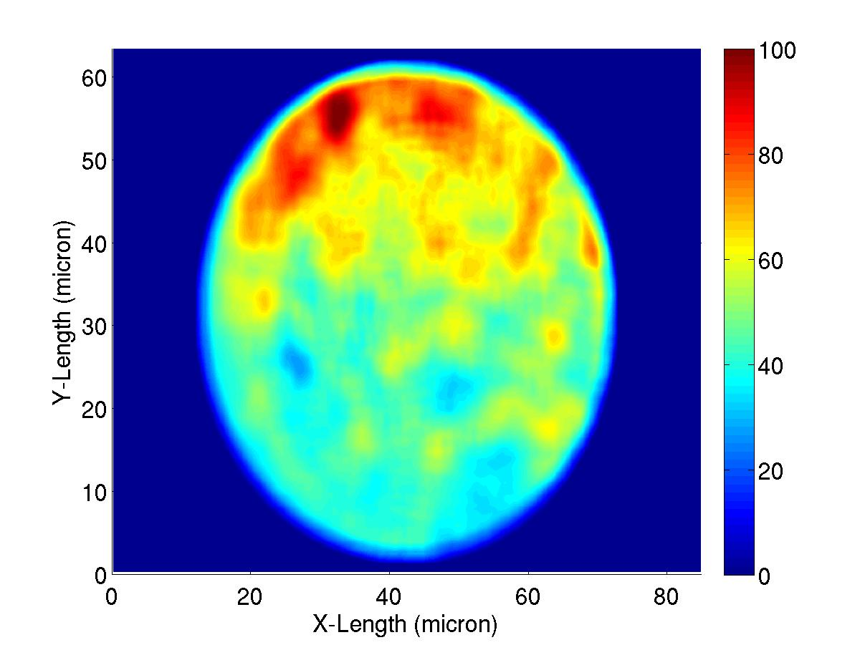
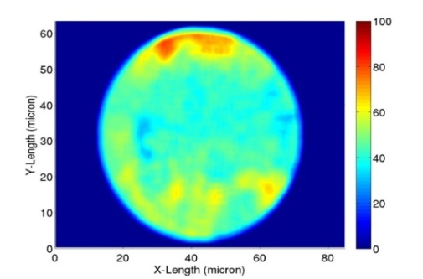
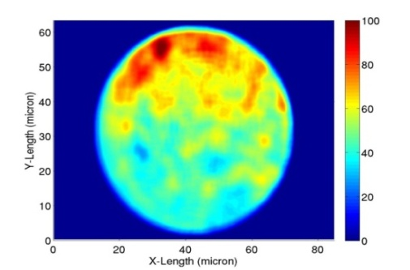
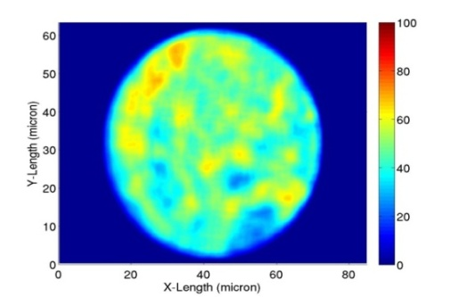
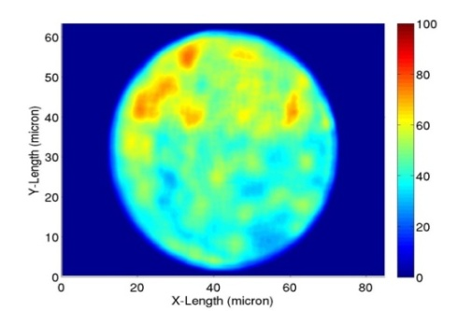
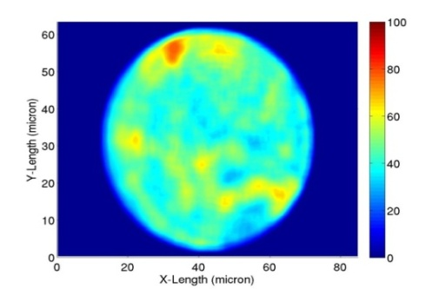
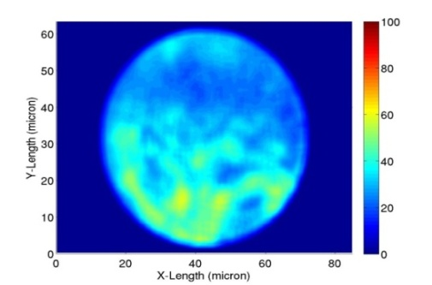
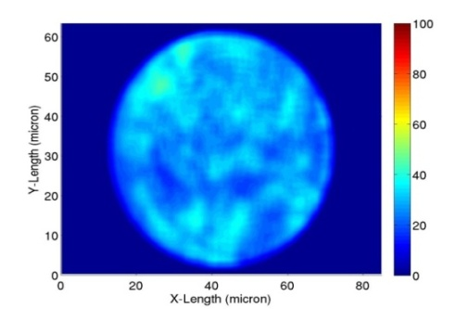
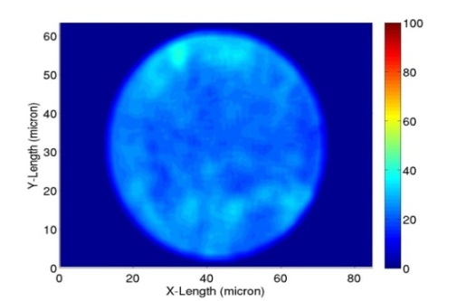
Measured Magnetic Field of Relativistic Electrons
Front
Time AND Space Resolved (Polarigram): Target Front
MG
0.2 ps
0.9 ps
1.1 ps
1.5 ps
2.5 ps
3.2 ps
4.1 ps
5.0 ps
5.5 ps
6.0 ps
6.5 ps
7.0 ps
Mondal et al., (manuscript under preparation)

Slide 31
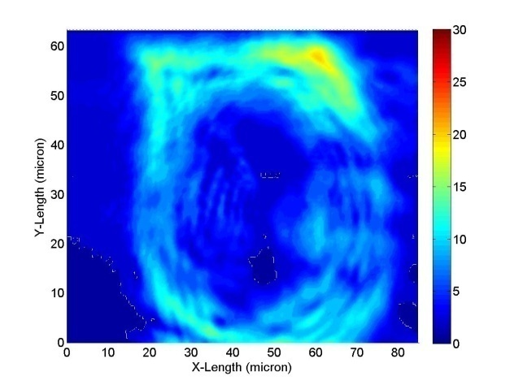
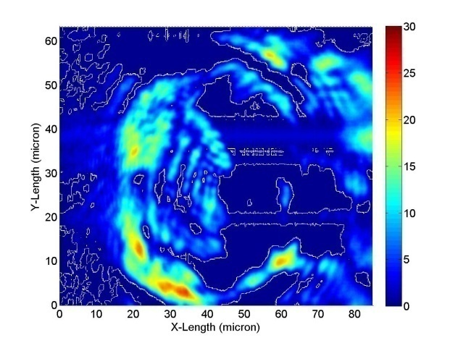
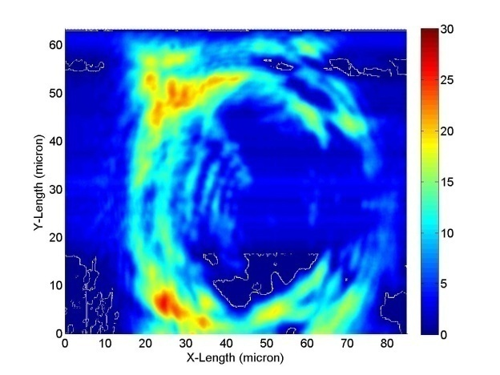
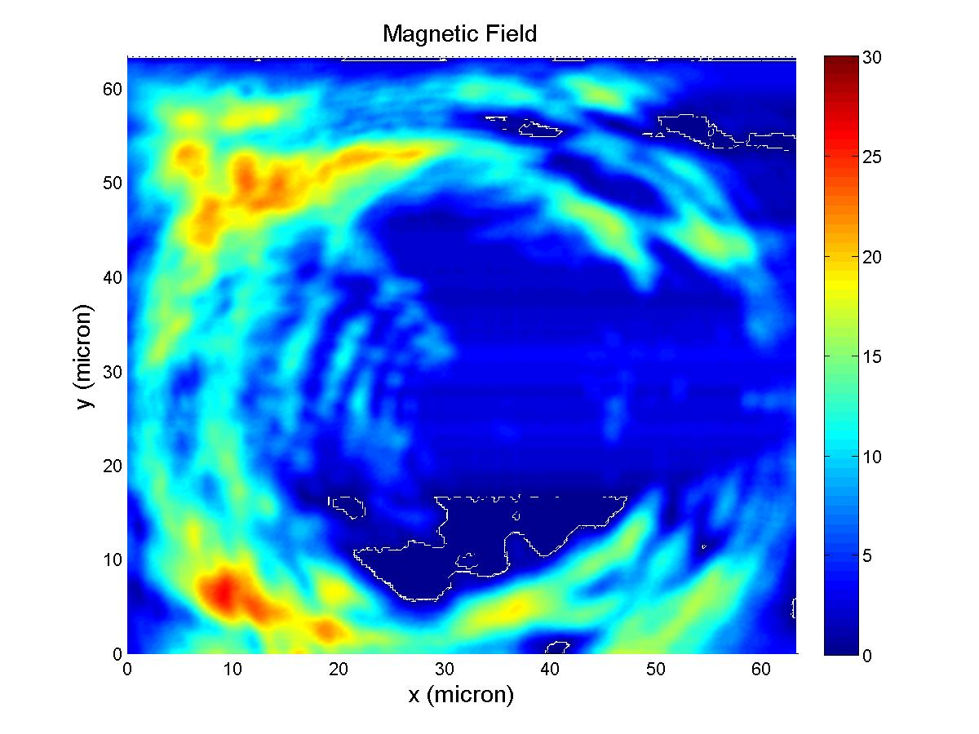
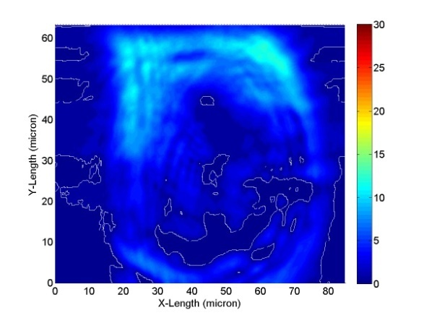
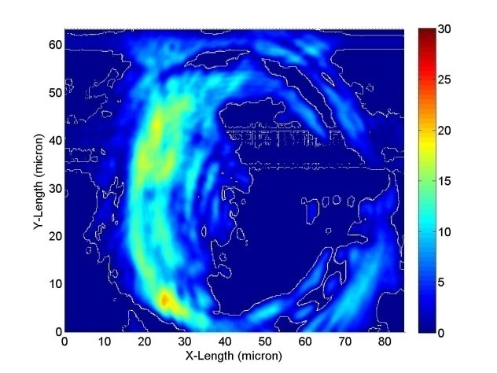
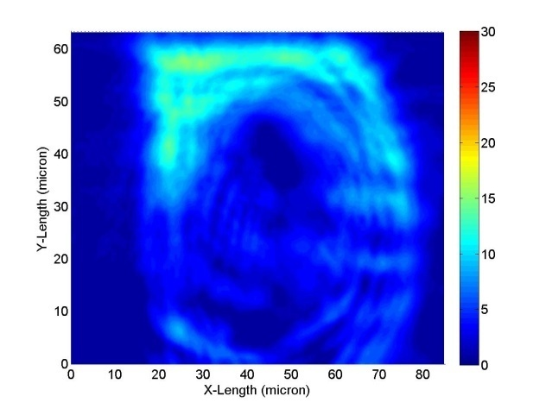
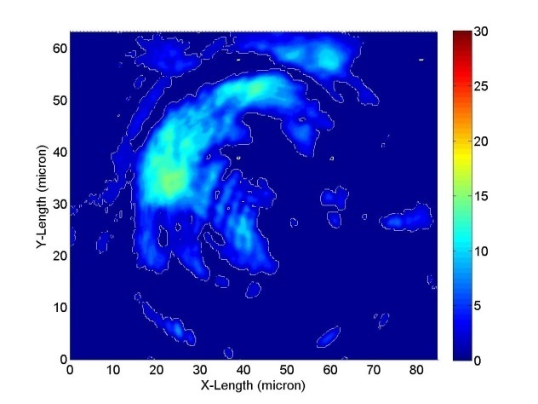
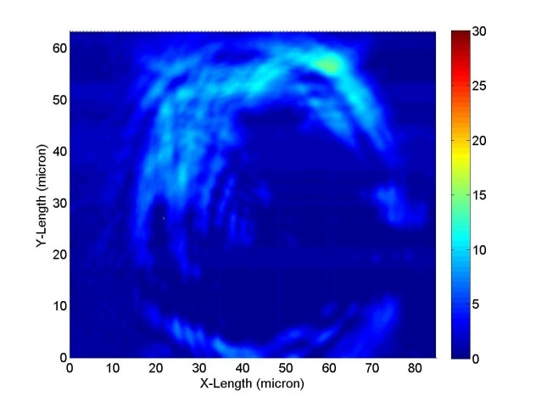
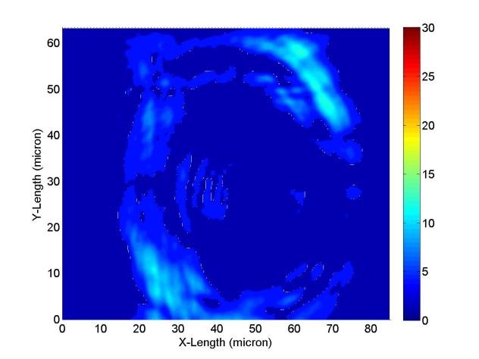
Measured Magnetic Field of Relativistic Electrons
Time AND Space Resolved (Polarigram): Target BACK
Back
MG
2.8 ps
5.5 ps
8.3 ps
Time Delay=11.1 ps ps
13.9 ps
16.6 ps
33.3 ps
49.9 ps
52.7 ps
Mondal et al., (manuscript under preparation)

Slide 32
Magnetic Field
Front
Back
First direct observation of filamentation and inhomogeneity!
(TIFR expts; 2008-2009, manuscript in prep.)

Slide 33
Conclusions
We report the first ever pump-probe dynamics of the critical surface of solid density plasma produced by relativistic intensity, femtosecond lasers
Spatial and temporal profile of magnetic field is captured simultaneously for the first time.
Evolution of electron filamentation captured
First measurements of magnetic field at the back of the target.
Notes:
33

Slide 34
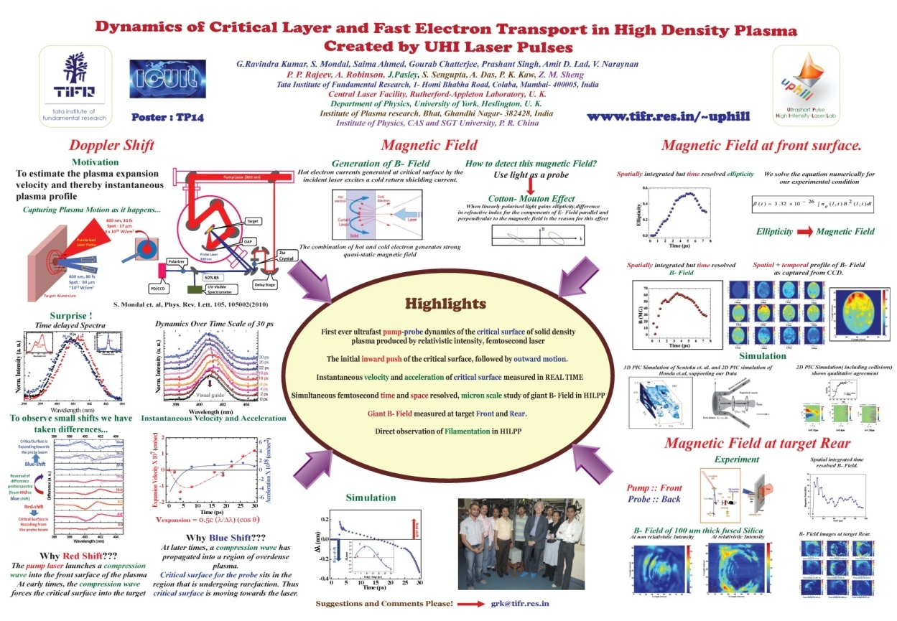
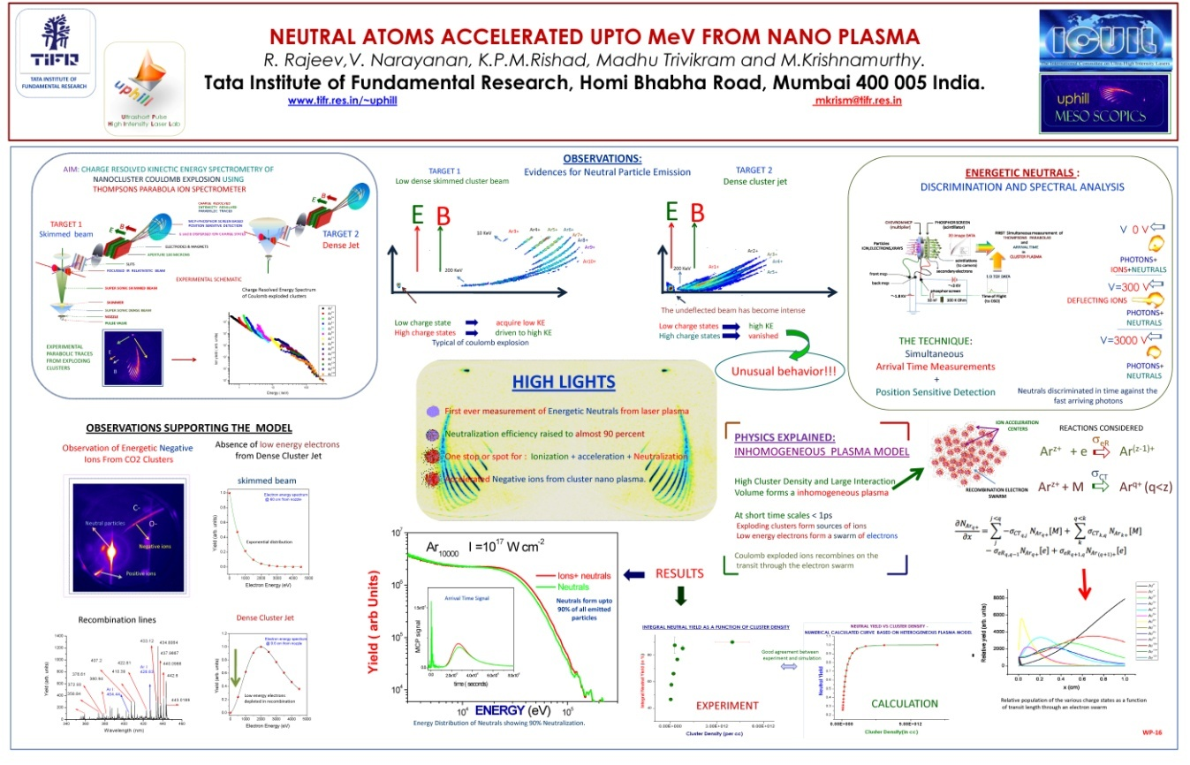
Thank you !!!

Slide 35
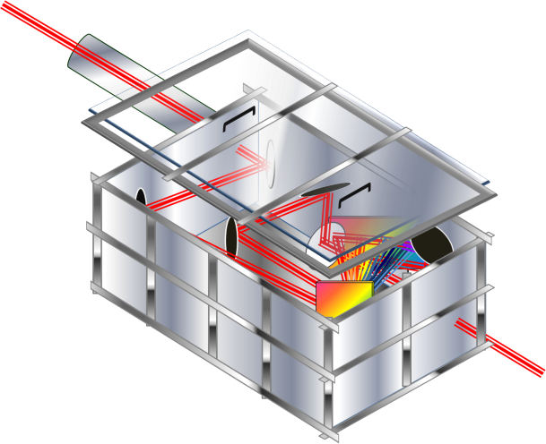
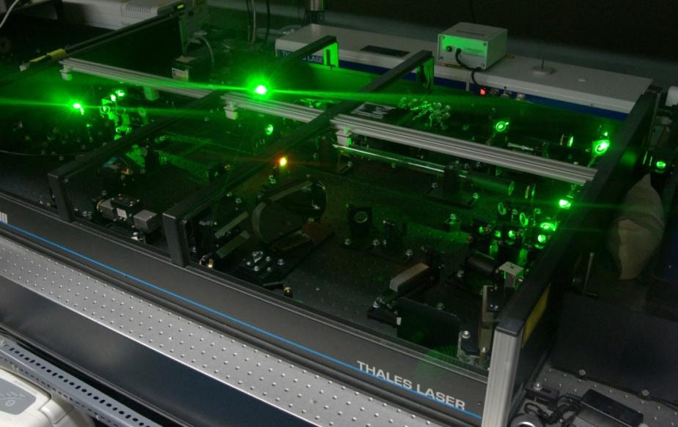
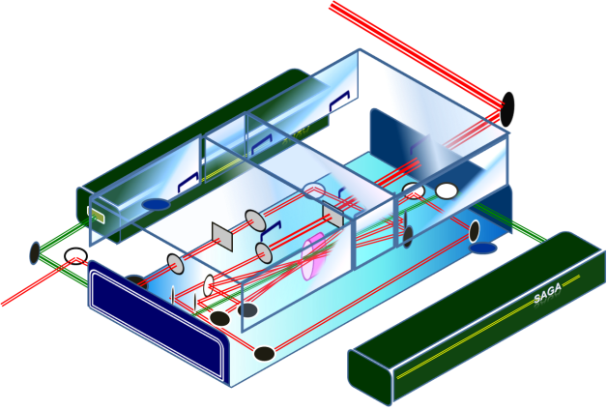
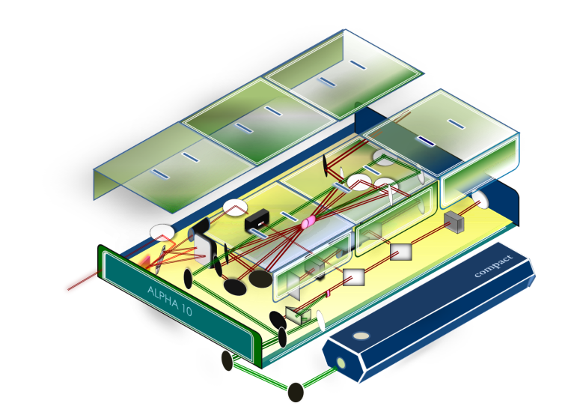
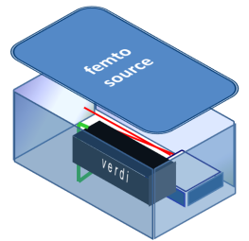
Ultrashort Pulse High Intensity Laser Laboratory
Tata Institute of Fundamental Research
20 TW
T⁵ SPECS
Wavelength = 800 nm
Maximum Energy = 1 J
Pulse width = 30 fs
Contrast >= 10⁻⁶
Repetition Rate = 10 Hz
Existing Laser

Slide 36
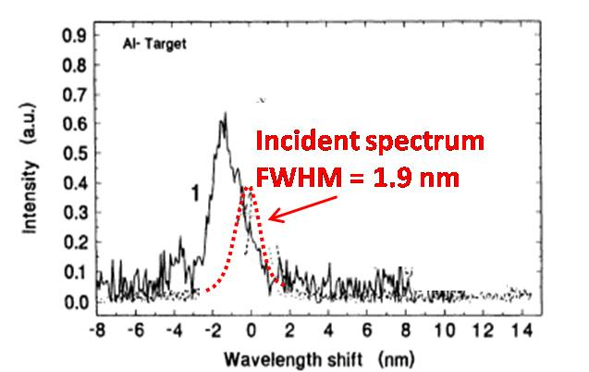
Dynamics by Doppler Shift – Earlier Experiments
Main Results :
The pump
self-reflection was used to measure its
spectral shift
No dynamics captured after the
intense laser pulse disappears
Spectrometer
I =10¹⁷ W/cm²
800 nm
2 ps
Target :
Aluminium
Kalashnikov, PRL 73, 260 (1994).

Slide 37
Dynamics Over 30 ps
Pump:
800 nm,
3 x 10¹⁸ W/cm²
Target : Aluminium
Probe:
λ = 400 nm
Visual
Guide

Slide 38
Single Shot Spectrometer
Resolution :
0.5 Å
Ocean Optics Spectrometer
(HR 2000)
Used for data acquisition
Range
λ
350 nm
445 nm

Slide 39
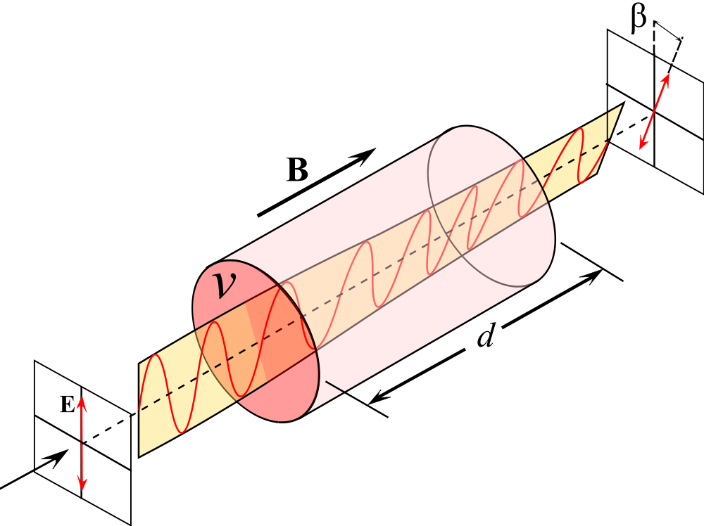
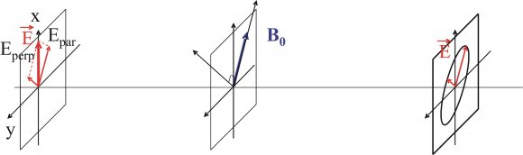
Measuring B by Polarimetry
Faraday Effect: (B // k) The linearly polarized
light gets rotated. Difference in phase accumulation
between LCP and RCP.
δϕ = (n₊-n₋) kz
Cotton-Mouton Effect: (B ⊥ k)
Linearly polarized light gains ellipticity,
Reason: Difference in refractive index for component of Electric field parallel and perpendicular to magnetic field.
Principle: Probe polarization changes due to magnetic field created by pump

Slide 40

Hot electron Transport
Generation and damping of B
Hot electrons J_{hot}
stream into bulk
Return plasma currents compensate
The electrical resistivity σ⁻¹ limits buildup and determines decay of magnetic field.
Source
Diffusion
Cold e⁻
Current loops
Hot e⁻
Laser
Solid
Plasma layer

Slide 41
Measuring Giant Magnetic Fields
Principle: Probe polarization changes due to magnetic field created by pump
Target
B
BS
λ/4
PD3
Pump
k
-k
Probe
Analyzer
Probe
PD1
PD2
Interaction Area
Pump-Probe Polarimetry

Slide 42
Spatial Matching of Two Beams
Pump
Probe
Probe Spot size ~60 μm
Pump Spot size ~17 μm

Slide 43
Temporal Matching of Two Beams
Probe ahead of Pump
Target
Before temporal matching
Pump
Probe after the Pump
Probe
30 fs
(99 μm)
80 fs
(264 μm)
t
After temporal matching
t
Beams are hitting a new
target spot every time
Pump and Probe arrive
at the same time

Slide 44
Pump-Probe Technique
Probe ahead of Pump
Probe ahead of pump
Reflects from Metal
Probe after the Pump
Now probe reflected from plasma
formed by the pump
Studying evolution of plasma
No plasma contribution as yet
Pump Probe Overlapped
Time = 0
Partly reflected from plasma
Pump and Probe arrive
at the same time

Slide 45

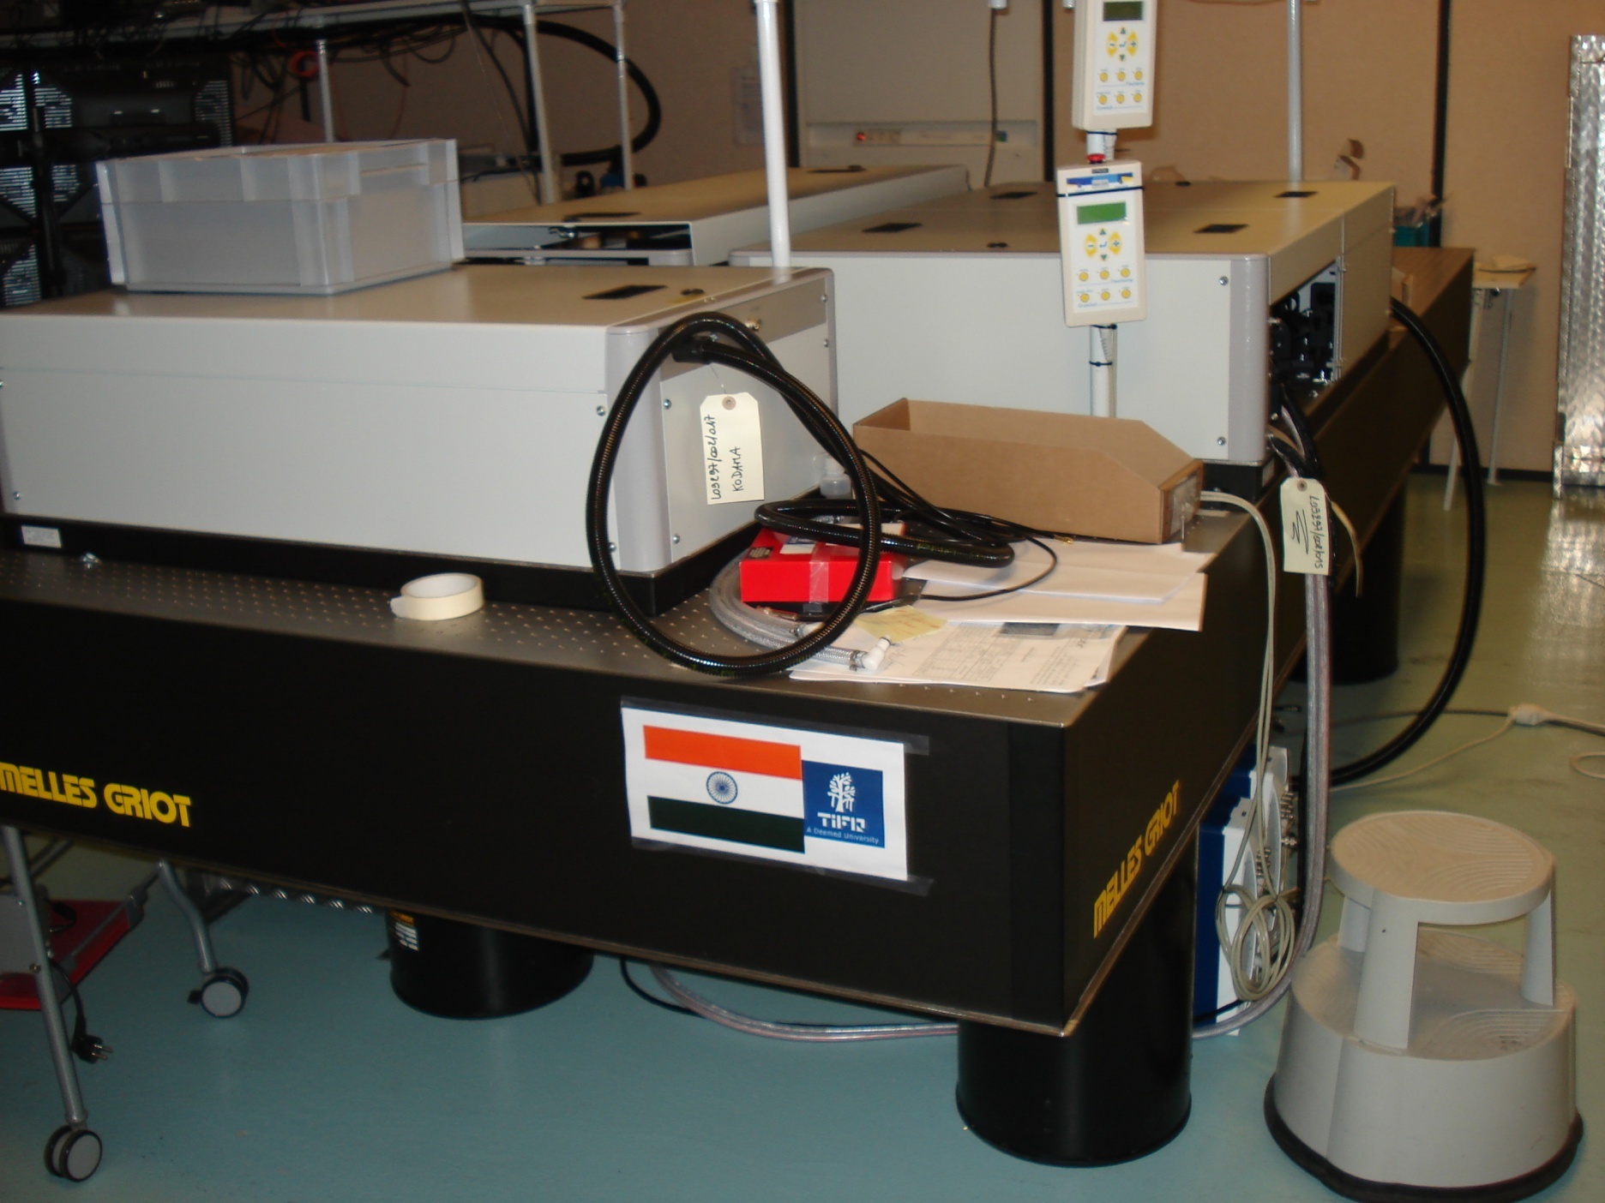
100 TW, 25 fs, 10 Hz (from April 2011)

